Slide 1
Cloud Computing for
State and Local Governments
John Roller, MCSE, MCSA, MCDBA, MCP+I, MCT, CISSP, CCNA, CTT, A+
Sr. Technology Strategist
State & Local Government

Slide 2
Agenda
Overview of the Cloud
  Why the Cloud?
  How Microsoft differs from other SaaS Providers
  Microsoft’s long term vision
  Cloud computing taxonomy
Windows Azure Platform
  Programming Support
  Service Offerings
Office 365
  Understanding the components
  What’s new in Office 365?
  Microsoft Data Centers and SLA’s
  Certifications
  References
How to buy Office 365 – suites, standalones, licensing and pricing
Demonstration
Next Steps – where to go for more information

Slide 3
Why the Cloud?

Slide 4


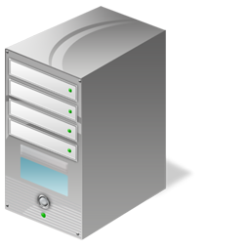


Why Are Organizations Considering the Cloud?
NEW ECONOMICS
REDUCED MANAGEMENT
INCREASED PRODUCTIVITY
Pay for what you use
Lower and predictable costs
Shift from capex and opex
Accelerate speed to value
No patching, maintenance
Faster deployment
Robust multi-layered security
Reliability and fault-tolerance
Latest software for users
Internet collaboration
Anywhere access
Instant self-provisioning
Notes:
Key Points:
The cloud can help save money, increase productivity and reduce management complexities
This can create new business opportunities
Script:
This ability to move things to the cloud, use the cloud for extra compute or storage or expose or share your services with others leads to some benefits:
First, it offers a new set of economic opportunities.
Gain better control over your money (New economics)
from saving money by not having to run and maintain large datacenters yourself
in some cases moving to IT as a subscription so that you only pay for what you use, when you use it
by giving you the opportunity to shift from capital expenses to operational expenses
Reduced management:
No patching and maintenance
Faster deployment
Robust multi-layered security
Reliability and fault-tolerance
Redefining Productivity:
by increasing access to information and applications
by increasing collaboration because many of the tools they use are now connected together
by helping your IT staff focus more on business and less on plumbing and hardware (no patching and maintenance, faster deployment, etc)
quickly adapt to changing business needs
New Economics
Reduced Management
Redefining Productivity

Slide 5
Why Microsoft?

Slide 6









Microsoft Is a LEADER In The Cloud
(2010)
400M+
consumers
at release
Web Applications
(2004) 2 Billion emails/day
(2003) 5 Billion conference minutes/year
Windows Live Messenger
(2001) 20M+ active users
(1999) 2 Billion queries/month
(1999) 320M+ active users
(1998) x100M users Largest non-TCP/IP cloud service
(1997) 550M users/month
(1996) 450M+ active users
Notes:
There are few people that question that Microsoft can write great software. What they want to know is whether we can map our success on the desktop and server’s, even mobile devices, to the cloud and develop innovative, scalable, reliable services there.
Let’s take a quick look back at just how much work Microsoft has already been doing in the cloud.
Windows Live Mail
450M+ users today, arguably the largest webmail service in the world ( about 3x the size of Gmail)
Also one of the first, and the first major web-based email service on the Internet (Yahoo Mail started 1 year after Hotmail)
MSN Portal
Has gone through some name changes but has been delivering various web-based services – MSN Money, MSN Autos, etc… since 1997
550M+ unique visitors per month
Windows Update
Most would not think of Windows Update as an Online service, but actually, other than TCP-IP services like DNS, it is the single largest cloud service in the world. <period> It has devices that connect in the high hundreds of millions worldwide, each month – to deliver updates directly to PCs and to WSUS servers that in turn deliver updates to machines on private corporate networks.
This service is really innovate – delivering the first major cloud-based patch management system, introduced with Windows 98.
It’s so Reliable that many people forget to think of Windows Update as a worldwide cloud service.
Windows Live Messenger
Launched in 1999 to consumers for Presence and IM, it now incorporates more things like Voice.
There are more than 320M+ active users that use WLM each month.
Bing
Our search… decision engine… that has various name changes over the years but has been Online since 1999.
2B+ queries per month using Bing
With recent Bing launch, introduced concept of a Decision Engine – going beyond basic searches to find locations and to improving the quality of actually making decisions/transacting on the web.
XBOX Live
Launched in 2001
First major cloud-based gaming community, and perhaps the most important differentiator in XBOX success to date
20+ million active users on XBOX Live.
There has been innovation with Xbox Live, which lets people Stream NetFlix over the internet, and stream Music through Last.fm. You can get games on demand, IM, and voice chat with others through the service.
Office LiveMeeting
Consumer and enterprise cloud collaboration and conferencing service
5B conferencing minutes last year alone
MS Online Services
Launched in 2004
Provides Enterprise productivity services to Cloud users.
We have over 2M paid seats
Process more than 2B emails a day
Office Web Apps
Office Suite capability in the Cloud – with full document fidelity, same look and feel as rich Office client, real time collaboration on docs, etc…
Available to over 400M+ Live ID users on the day of release
Available as a service to all Facebook Users through a joint solution called “Docs” which we announced and released in April 2010.
So, you get the picture. Microsoft has been delivering Cloud services successfully for 15 years.

Slide 7
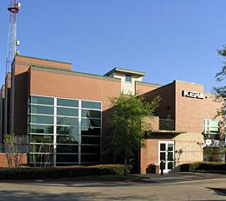

Sometimes…
I don’t want to own the TV station.
I just wanna watch TV.

Slide 8



Broad Innovation
Microsoft’s Long-Term Vision
Established 1996
450+ Million Users
Ad Funded (free)
Consumer based
features & infrastructure
First Released 1996
Used by most
Fortune 500, SLG, and Federal agencies
Enterprise based
features & deployment
The decision was not difficult…
Enterprise Foundation for an Enterprise Cloud Offering
Notes:
The thought process that prospective cloud vendor uses to conceptualize and deliver services should be of considerable importance to you. This is because of the foundation the provider chooses for their Enterprise Services may weigh heavily on their ability to serve your evolving requirements down the road.
Let’s take Microsoft and Email as one example of this.
Hotmail (as was mentioned earlier)
Architected to prioritize very heavily on scalability and convenience
450M+ users. Again the largest cloud mail system out there. We know how to do mail in the cloud.
Funded with ads (so free to consumers)
Lightweight web-based client for most users
When planning for our new enterprise cloud offering, we could have started with Hotmail, bundled hosted filtering/archiving, bumped up the storage a bit, attached an SLA and been done.
{Click}
But you may know Hotmail and Exchange Server were launched in the same year…1996…and yet have very different business/architectural models and design elements.
{Click}
Looking at Exchange, our other model is…
The defacto experience for most enterprise customers in government and business
Designed to balance reliability, scalability, usability AND other critical requirements like compliance/security
Multitude of clients – rich, web, phone
In the not to distant past – we could have approached our Enterprise Customers that were already accustomed to Exchange and these important differentiators we mentioned. Proposed that we wrap an written contractual SLA around Hotmail, and remove the Ads and offered it as a Cloud Service for Businesses. If Microsoft did something like that, they no doubt would have felt their systems were being demoted and moved further from their requirements and an Enterprise, not closer to them.
{Click}
So in the end, we decided whether in the cloud or on-premise, we needed to opt for an Enterprise Foundation for an Enterprise Cloud offering.

Slide 9






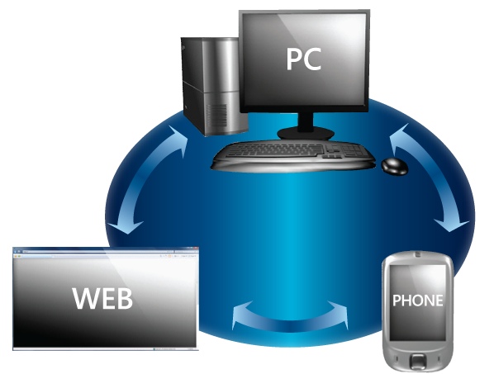

Microsoft’s Deployment Models
Power of Choice
On-Premises Servers
Private Cloud
Government Cloud
Public Cloud
Deployment Choice
Interoperable by Design
  A balanced long-term
  vision for computing
Seamless User
Experience
Notes:
On-premise Servers
On-Premise deployment is what enterprises are most familiar with and is still the most common method of providing IT services. A server is provisioned either physically or virtually to run a network servers or host an application.
Private Cloud
The idea behind a Private Cloud is to emulate public cloud computing on private network. In this model an Enterprise deploys and manages its own network services, security, applications, but takes advantage of server virtualization and management software to create a Dynamic Datacenter in which automation is used to move virtual servers among hardware hosts, or spin up and turn off servers as needs dictate. Identity Management, SSO, self-service portals, and automation tools are required to build a private cloud.
Benefits of this model is the Enterprise maintains complete control over all of their data, applications and the datacenter and should require less hands-on management in the longer term.
The drawback is that an enterprise has to buy, build, and manage the hardware and software systems. Retraining IT staff and hiring a third party consultants such as MCS, is also needed to assist with the architecture, design, and implementation. The up-front capital costs can be steep and essentially lacks the economic model that other clouds models provide.
Private Clouds can also be hosted internally or by hosting providers which would supply the expertise, architecture, design, implementation, management, and operations of dedicated computer systems located at the hosting providers data center on behalf of a customer. This includes maintaining SLAs, securing the data center and customer’s data, patching, upgrading, and performing maintenance on the systems. This enables the customer to concentrate more on its core business rather than running IT infrastructure. The enterprise still has control over the services and can customize their systems similar to what they can do in an on-premise deployment.
It can take a number of months for an enterprise or hosting provider to architect, provision, and migrate data to the dedicated system. Monthly costs are typically higher than in a public cloud model until you reach a certain number of users. There also may be higher upfront costs coming from CapEx to get the services built and deployed, although a hosting provider may roll these costs into a monthly fee and average the costs out among the term of the contract so a business can pay out of OpEx.
Government Cloud
The Government Cloud is similar to private clouds in that systems and data is provisioned on dedicated computer systems in a hosted datacenter. This allows the hosting provider to separate the government data from shared systems and place higher security restrictions on the systems – such as what security certifications or governance regulates the datacenter and the staff with potential access to the data.
This model is flexible in that a government organization may desire shared services between its different agencies to bring down costs, reduce information silos, better collaborate with one another, and have a single Identity Management and SSO solution for the government entity. This model should fit State Government well and even large Municipal governments where departments are not interconnected today.
Public Cloud
Public Cloud are used by several diverse organizations that have similar requirements – such as a need for common applications, a common development platform, or common infrastructure for running VMs. The shared multitenant infrastructure helps all of the entities to realize some of the benefits of cloud computing, and reduce costs.
Hosting providers maintain robust infrastructure and subscribers avoid a large upfront cost, and gain the ability to add a small number of users to a service, where deploying an on-premise solution could not be financially justified.
The drawback to this model is that the services are less customizable than an on-premise or a Private Cloud deployment. Integration with existing user applications and network services vary widely among the public cloud providers.

Slide 10
Cloud Computing Taxonomy
The Windows Azure platform fits here
Traditional IT
IaaS
PaaS
SaaS
You manage
Applications
Applications
Applications
Applications
Data
You manage
Data
Data
Data
Runtime
Runtime
Runtime
Runtime
Managed by vendor
You manage
Middleware
Middleware
Middleware
Middleware
Managed by vendor
O/S
O/S
O/S
O/S
Managed by vendor
Virtualization
Virtualization
Virtualization
Virtualization
Servers
Servers
Servers
Servers
Storage
Storage
Storage
Storage
Networking
Networking
Networking
Networking
Notes:
For WAPU: This slide shows how the various options compare, then explicitly illustrates where the Windows Azure platform fits in. It’s meant to make clear in the audience’s mind the exact place in this broad area that we’re about to dig into more deeply.

Slide 11


















Introducing the Windows Azure Platform
Internet-scale cloud services platform
Hosted in Microsoft data centers around the world
Provides a simple, reliable, and powerful platform for creating web applications and services.
  Developer Experience
  Use existing skills and tools.
Compute
Storage
Management
CDN
Relational data
Data Sync
Connectivity
Access control
Notes:
Key point: The Windows Azure Platform is a set of cloud computing services that can be used separately or together.
Windows Azure is hosted in Microsoft data centers around the world. Windows Azure provides compute power, storage, and automated service management, as well as easy connectivity to other applications and access control to provide secure authorization and authentication of access to cloud resources.
Also hosted in the Windows Azure platform is Microsoft SQL Azure, providing relational database services and automated management of relational service. SQL Azure can help reduce costs by integrating with existing toolsets and providing symmetry with on-premises and cloud databases.
Windows Azure AppFabric helps developers connect applications and services in the cloud or on-premises. This includes applications running on Windows Azure, Windows Server and a number of other platforms including Java, Ruby, PHP and others. Windows Azure AppFabric provides a Service Bus for connectivity across network and organizational boundaries, and Access Control for federated authorization as a service.

Slide 12











Microsoft Online Services
Windows Azure Platform
Build native Cloud Apps using Visual Studio 2010
Open platform supports 3rd party tools and languages
Dynamic scaling to handle peaks in demand complexity
Reduce IT complexity with automated service management
Create separate environments: Development, Staging, Production
Host your own VMs on Azure.
Dynamic scaling handles demand
Ecosystem of familiar Development & Management tools
TSQL support and familiar relational database model
Multi-tenant, auto high availability, self-managed and provisioned
Connect across on-premises, cloud and hosted resources
Handle identity and access across organizations and ID providers
Navigate network and security, securely and simply
Interoperate across languages, platforms via standards
Support for .NET, Ruby, MySQL, Phython, PHP and Java
Notes:
The Windows Azure platform comprises the following services:
Windows Azure hosts Web applications and stores simple application data in blobs, tables, queues, and virtual drives
SQL Azure Database hosts relational databases using Microsoft's SQL Server technology and supports queries in T-SQL, the query language used by that server
AppFabric Service Bus is based on Microsoft's Windows Communication Foundation technology and enables disconnected application components to exchange messages across organizational boundaries
AppFabric Access Control simplifies authentication and authorization in applications composed of components located in multiple locations on the Internet
Windows Azure platform services are not complete replacements for on-premises servers. For instance, Azure doesn't provide customers administrator access to Windows Server virtual machine instances (although this feature will be available later in 2010), and SQL Server's business intelligence features are not yet available through the SQL Azure hosted data management service.

Slide 13

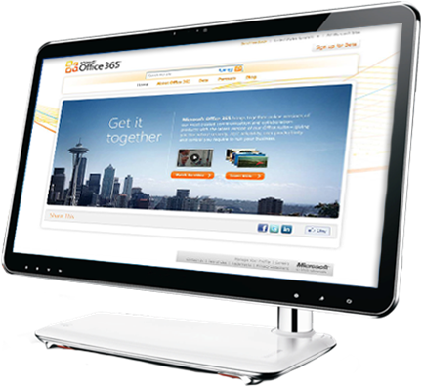
Bringing together Cloud versions of our most trusted
Communications and Collaboration products with the
latest version of our Desktop Suite for Businesses of all sizes.
Notes:
Building upon our success in the marketplace and based on what we have heard from our customers, with Office 365 we will be introducing a set of new features across all workloads and the platform

Slide 14




Microsoft Online Services
Flexible service offering with pay-as-you-go, per-user licensing
The complete Office experience with services integration in Office 365
Latest version of the Office Apps, including Office Web Apps
Familiar Office user experience to access services
Voicemail with unified messaging
Integrated personal archiving
Retention policies and legal hold
Exchange Control Panel
Free/busy coexistence
Cross-premises management
My Sites to manage & share documents
Offline document access
Improved Team & Project Sites
Document-level permissions to protect sensitive content
Extranet Sites to securely share docs
Cross site collection search
IM & Presence across firewalls
GAL/Skill search in SharePoint
Online meeting with desktop sharing
Contact photos
Click-to-communicate from Office contact cards
Windows Live federation
Platform
Capabilities
New user interface
Role based access
Identity federation (eliminate sign-in client)
Multi-factor authentication support
Remove scale limitation
Notes:
User Segment Offers: Plan E Family
25GB mailbox
500 MB SharePoint storage
Client connectivity
Mobility
OCS capabilities
Exchange & SharePoint capabilities
Office Professional Plus
On-premises access rights
User Segment Offers: Plan K Family
500 MB mailbox
Outlook Web App only
POP support
Messaging, calendar, contacts
Forefront antivirus and anti-spam
SharePoint Access (0MB storage)*
Site search capabilities
Office Web Apps
*K Plan Users w/ Web Apps will be able to open, edit, save existing documents, or create documents from templates in the libraries.
They will be able to participate in Wikis and Blogs created by others as well.
This will take from the pooled storage. They will not be able to upload new documents into SharePoint.
E Plan Key Differentiators
Client Connectivity
Mobility
Additional Storage
Exchange to 25GB
SharePoint to 250MB
Application Sharing
OCS Capabilities
K Plan Key Differentiators
Outlook Web Access
500 MB Mailbox (No Add-on)
Active Virus / Anti Spam
Access to GAL
Personal Contacts
Calendar
SharePoint Access (0 MB)
Office Viewers

Slide 15






The Office 365 Service Offering Includes…
Flexible service offering with pay-as-you-go, per-user licensing
The complete Office experience with services integration in Office 365
Simplified user setup to preconfigure services
Always the latest version of the Office apps, including Office Web Apps
Familiar Office user experience to access services
Share important documents, insights, and status with colleagues
Keep teams in sync and manage important projects
Find important documents and people easily
Stay up to date with company information and news
10 GB per tenant + 500 MB per user
25 GB Mailbox
Outlook and Outlook Web App
Premium antivirus/antispam (Forefront)
Shared calendars, contacts, and tasks
Mobile email for most mobile devices including
BlackBerry*, iPhone, Nokia, Windows Phone
Email archiving and compliance capabilities
Instant messaging and presence
PC-to-PC audio and video calling
Click-to-communicate from Outlook, SharePoint, and other Office Applications
Online meetings with PC-audio, video conferencing, and screen sharing
Single-click meeting creation and join from Outlook
Calendar integration with Outlook and Exchange
CONTROL AND EFFICIENCY
Single user interface to purchase, administer, and user with RBAC | Single sign-on with on-premises Active Directory |
99.9% financially backed SLA | 24x7 IT pro support | Built in geo-redundancy in regional data centers
Notes:
Lync Online:
By 2013, 95% of workers in Global 100 organizations will use the IM client
as their primary interface for computer-based, real-time communications.”
(Source: Gartner, MarketScope for Enterprise Instant Messaging and Presence. 10/8/2010)
Office Professional Plus
With Microsoft® Office Professional Plus, you get the latest version of the Office applications, seamlessly connected and delivered with cloud services, so you can access your documents, email, and calendars from virtually any device. Office Professional Plus includes the new Office Web Apps, online companions to Word, Excel, PowerPoint, and OneNote, which let you review and make light edits to documents directly from a browser.
Features:
The flexible pay-as-you-go, per-user licensing of Office Professional Plus provides your organization with purchasing flexibility, and robust management and deployment tools give you the IT control to adapt to evolving business needs.
Master your inbox and calendar with Conversation View and other advanced management tools in Outlook
Leverage the power of business and social networking right within Outlook with the Outlook Social Connector
Collaborate with control and confidence with co-authoring
Instantly share slideshows, across town or around the world with PowerPoint Broadcast Slide Show
Create presentations that are as brilliant to watch as they are easy to create with new video and photo editing tools in PowerPoint
Quickly work with hundreds of millions of rows of data in Excel. Transform enormous quantities of data into meaningful information
Work from virtually any place and any device with the Office Web Apps ¹
SharePoint Online
Microsoft® SharePoint Online brings together the familiar SharePoint Server technology now delivered as an online service making the power of the cloud work for your business. SharePoint Online provides a central place where people can create sites to connect colleagues, partners and customers.
Features:
Access to a personal site for individuals to store documents, share interests and quickly access their content from anywhere
Designed to work with the Microsoft Office applications individuals having been using for decades
Business units or workgroups can create team sites to share documents, task lists, and schedules to keep everyone in sync
Create project sites using SharePoint Online to automatically track documents, monitor project tasks, and milestones
Create sites to communicate business priorities and information to the entire organization
Build vibrant and engaged communities inside and outside your organization
Create sites to manage and share information securely with partners and customers
Social Networking capabilities such as activity feeds, blogs and wikis to help build community
Financially-backed, guaranteed 99.9% uptime Service Level Agreement

Slide 16




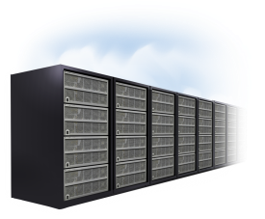

“We were cautious of how many people would embrace a new tool. What we found was that 80% of our users wanted to be on a Microsoft-type platform and were using one at home.”
  John Kalka, Vice President,
  Ingersoll Rand
“Older Millennials (23-27) spend an ave. of 6.8hrs/w interacting with work email. Younger Millennials in work spend just 4.2hrs/w on email and more time on text messaging (3hrs) or IM (3.2hrs).”
  Accenture, Jan. 2010
“The move to Microsoft Online Services will help cut operational costs by an estimated 30% and create a variable cost model that will provide increased flexibility in the future.”
  Ingo Elfering, Vice President,
  GlaxoSmithKline
CONSUMERIZATION
MULTI-GENERATIONAL
INFRASTRUCTURE LIMITATIONS
Trends Driving the Future of Productivity
“The world's mobile worker population will pass the 1 billion mark this year and grow to nearly 1.2 billion people – more than a third of the world's workforce – by 2013.”
  IDC, Feb. 2010
“By 2012, 20% of businesses will own no IT assets.”
  Gartner, Jan. 2010
ANYTIME, ANYWHERE
RISE OF THE CLOUD
Notes:
Customers are saying several factors are driving the future of productivity.
Increasingly Challenging Environment:
Consumerization of IT
Insecure, risky consumer-grade applications installed by enterprise users
Demand for popular capabilities (social networks, IM, blogging, mashups, etc.) at work
Sharing of enterprise data on public networks (LinkedIn, Facebook, etc.)
Multigenerational workforce
3 generations – Boomers (b.1946-1962), GenX (1963-1980), Millennials (b.1981-2000) with different workstyles and attitudes toward technology
80 million Millennials in U.S., 3.6B worldwide – 4 million enter U.S. workforce each year
Boomers deferring retirement, second careers
Rise of the cloud
Main customer concerns: control, security – still questions about cloud in minds of some
20% of businesses will own no IT assets by 2012
Most enterprises looking at hybrid cloud/on-premise deployments
Infrastructure cost and complexity
Too many systems/vendors in data center
Average $1B company maintains 48 disparate financial systems
Complicated by M&A activity, need to maintain legacy systems
Diverse and distributed workforce
Remote workers – 84% of organizations have a remote workforce
Increasingly sophisticated mobile apps, mobile devices
Increasing use of contingent staff, contractors, outsourcing

Slide 17
Continuous Investment
90-days roadmap communicated
Field, partner, and customer inputs
Rhythm of the Service
6-8 weeks feature prioritization and dev. sprints
Top feature requests identified
Notes:
We have been making continuous investment and upgrades to the services we introduced. We work with our customers and partners and get their input on scenarios and features, which helps us to identify top features and prioritize those. Below is a list of key feature upgrades since the launch of BPOS:
Jan 2010
Outlook 2003 Connector
Exchange Online Usage Reporting
Expand Languages and Markets
CRM integration with Exchange Online
Delegate Administration
Multi-tenant Blackberry Device Support
March 2010
25 GB mailbox storage per user default
Extend SharePoint site collection limit
Improved domain management
File attachments to service requests
Support for Mac OS X Snow Leopard
Publication Process
Enhance service communication via RSS
April 2010
Extend service in 17 additional markets
July 2010
Hosted Blackberry Administration Center
Office 2010 support
Enhance Powershell scripting
Preview Q4 2010
Update with Exchange Server 2010
Update with SharePoint Server 2010
Update with Lync Server 2010
Office Web Apps
Free/Busy co-existence
Single sign on with identity federation
Redesigned user interface
More administration and access control

Slide 18



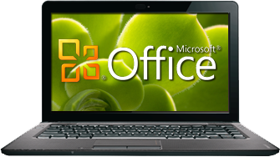



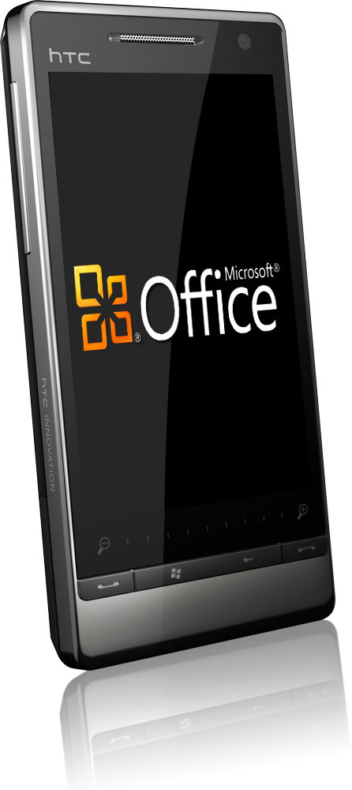
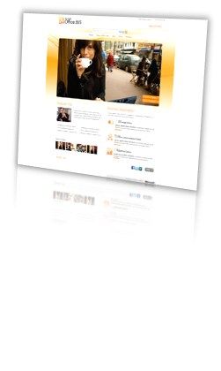






Microsoft Office 365 Value
ENTERPRISE SECURITY AND RELIABILITY
Premium anti-spam and antivirus protection provided by multiple virus
scanning engines
Data is replicated in geo-redundant datacenters to protect against
datacenter wide failures
Risk mitigation multi-dimensional approach to help safeguard services
and privacy of data
Helps customers comply with ISO 27001, SAS 70 Type I, FERPA, HIPAA, FISMA, EU Safe Harbor Seal
Backed by a 99.9% financially backed Service Level Agreement
BEST PRODUCTIVITY EXPERIENCE
Work together, smarter
WORKS WITH
WHAT YOU KNOW
Familiar tools
ROBUST SECURITY AND RELIABILITY
99.9% uptime.
Guaranteed.
IT CONTROL
AND EFFICIENCY
Keeps you
in control
ACCESS
ANYWHERE*
Solve problems
from more places
Geo redundant datacenters
99.9% financially backed SLA
* Access from mobile devices depends on carrier network quality and availability
** “Connect Securely” is not a guarantee of 100% connection security.”

Slide 19
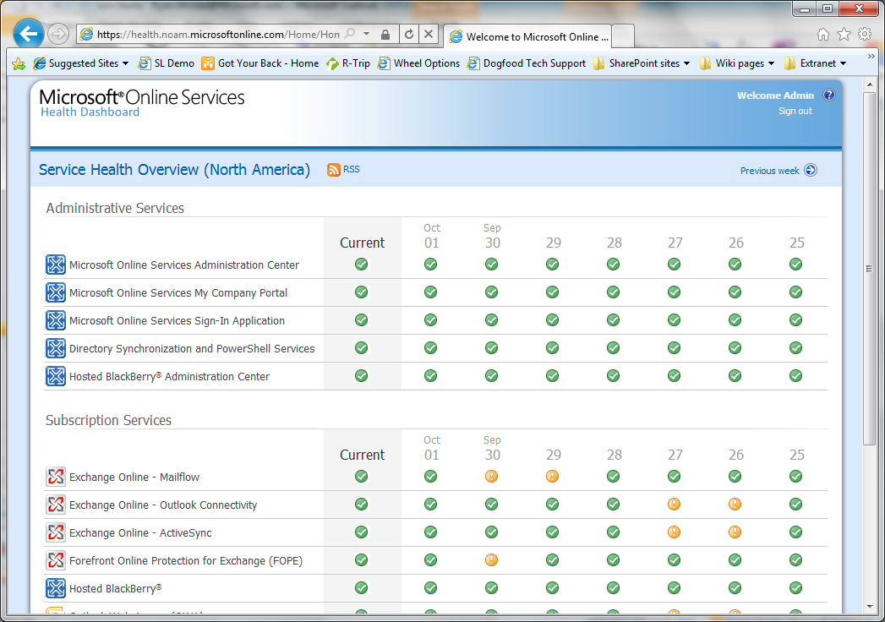
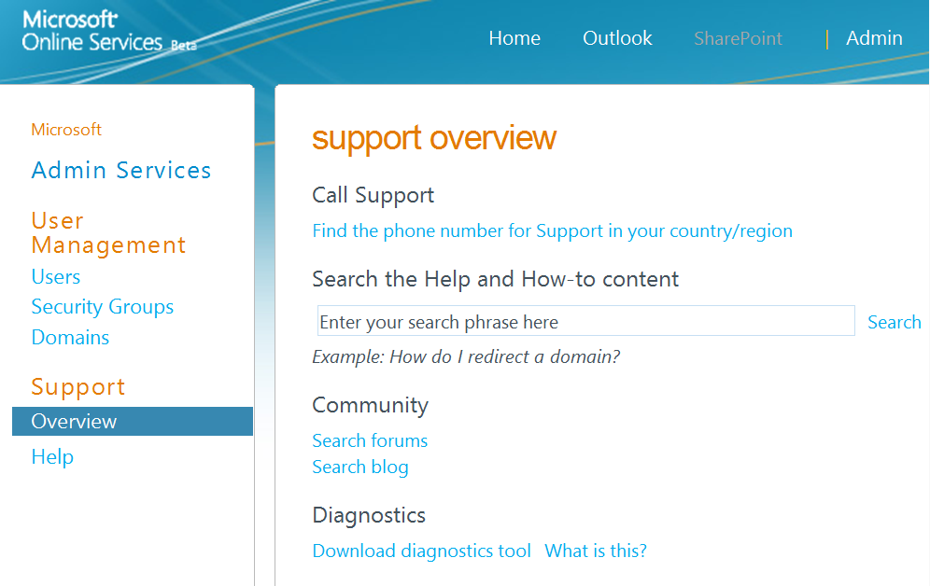
Microsoft Office 365 Value
IT CONTROL AND EFFICIENCY
24/7 IT professional phone support or via electronic ticketing
Service health portal and RSS feeds to provide up to date service availability information
Simplified management with a single administration center with role based access
Remote PowerShell to allow scripting of routine tasks and access to raw data for reports
IT friendly service update policies that put you in control
BEST PRODUCTIVITY EXPERIENCE
Work together, smarter
WORKS WITH
WHAT YOU KNOW
Familiar tools
ROBUST SECURITY AND RELIABILITY
99.9% uptime.
Guaranteed.
IT CONTROL
AND EFFICIENCY
Keeps you
in control
ACCESS
ANYWHERE*
Solve problems
from more places
Service health portal
Simplified Management
* Access from mobile devices depends on carrier network quality and availability
** “Connect Securely” is not a guarantee of 100% connection security.”

Slide 20


World-Class Data Centers
$2.3B+ investment in cloud infrastructure
Geo-redundant data centers
Locations in North America, Europe, and Asia to provide optimal performance
99.9% guaranteed uptime (99.95% actual)
Secure infrastructure
Built from the ground up to be environmentally sustainable

Slide 21





Highly Secured Datacenters
Business Class Reliability and Security
Delivering highly secure, private, and reliable computing experiences based on sound business practices
Key Features
Geo-redundant datacenters
N+1 architecture
9 layers data security
CyberTrust certified
Secure access via SSL
ITIL/MOF operational practices
24x7x365 support
Backed by 99.9% uptime SLA
4 hour RTO, 2 hour RPO
Filtering Routers
Firewalls
Intrusion Detection System
System Level Security
Application Authentication
Application Level Counter-measures
Virus Scanning
Separate Data Networks
Authentication to Data
Notes:
One area that we are very conscious of is the importance of security and availability. We want to ensure that customer feel confident that we are protecting their data and the service is highly available. Our service runs on a set of datacenters that are managed by a centralized organization within Microsoft that are making major investments in datacenter spaces and capabilities. We deploy our service on the latest hardware and network equipments in a N+1 architecture to enable failover capabilities as well as saving your data in a separate geo-redundant location. We are regularly tested by a third party CyberTrust to ensure our infrastructure is secure against attacks. We follow ITIL/MOF in our operational processes and we are in the process of getting our SAS-70 audit to ensure we have strictest level of control.
Above all, we will provide 24x7 IT Pro support and our service availability is backed by a 99.9% uptime SLA with financial penalties if we fail to meet the SLA.
Physical security is but one part it. When you look, we ultimately need to make sure that since we are providing an internet based service, we are protecting customer’s data in a variety of ways. We look at this as multiple layers of protection. Microsoft is actually providing 9 layers of logical security for our customers and their service and data.
Filtering Routers: these are implemented to protect against any traffic we do not see as well constructed. One of the great benefits of providing a focused service like BPOS is we actually set up the routers to protect against any form of malform data. We block at an aggregate at the edge.
Firewalls are set up as deny all.
Behind the firewalls we have an Intrusion Detection System. We have a very sophisticated correlation engine for any intrusion alert that we’re tracking 24 hours a day.
Below the IDS, we have a level System Level Security. When you look, the service operations organization actually has broad based, dual factor authentication. This means each individual within a support and service operations team have either some sort of secure ID card or a RSH secure ID token that is coupled with their role. Each individual must have a user ID and password and must apply a pin with their secure ID token. Based on the role they have, we grant access per individuals to the service.
Application Authentication: when you get below the System Level Security, the customers actually have application level authentication. We have a very sophisticated mechanism by which we provide access to data. The structure of the service provides users access to only those capabilities they are designed to have.
In the reseller model where a partner is actually providing the service to the customer, they have a level of application authentication that sits over top of that which the customers have. So we’re able to provide a very rich set of security protocols for our customers, as it relates to authentication to the different services.
Microsoft, as most people know, has a good history as relates to security and trustworthy computing. Our services are actually designed to make sure that we apply those security methods not only to the software, but we also treat that software as a service. So when we do our threat walling and follow the Windows initiative, we’re thinking about our applications as if they are delivered through the Internet. We apply a significant level of counter measures, such as buffer overflows and SQL injection, we make sure that the applications we’re running are sandboxed so you can’t activate elevated levels of security or access a higher level of authentication when you’re actually doing work within our application.
Virus Scanning is provided for multiple set of capabilities. We actually virus scan at all over our server levels, we have in place intrusion detection at the host and we’re scanning our content via Microsoft ForeFront.
Then we have Separate Data Networks. When you look inside the data center, So what when we do our threat walling and follow the Windows initiative. These are implemented in a form that breaks it apart. For example, the data bases are on a separate sub net then from the actual content server or something that is an internet facing device.
When you look, even though we are an internet facing service, very few devices have direct access to the internet. All of the servers are on some form of non-routable subnet space.
Finally you are authenticated into the data. The data itself is never stored on the physical servers, we run separate data networks and the data is stored on dedicated storage devices. So when you look at the content, the content is actually being sent from dedicated storage devices, which allows us to provide significant levels of backup as well.

Slide 22
Certifications in Office 365
Certification | Audience | BPOS Standard | Office 365
ISO 270001 | All customers | Yes | GA
EU Safe Harbor | EU customers | Yes | GA
SAS-70 Type I (SSAE SOC 1 Type I) | Primarily US customers | Yes | Q4 CY2011
SAS-70 Type II (SSAE SOC 1 Type II) | Primarily US customers | No | H2 CY2012
FISMA | US Government | No | H1 CY2012
HIPAA/BAA | US Life Sciences | No | Exchange Online: June 1 via escalation Lync Online: Q4 CY2011 SharePoint Online: H1 CY2012
EU Model Clauses | EU Customers | No | EA customers can sign June 1, effective Q4 CY2011 Effective for all customers Q4 CY2011
Data Processing Agreement | EA Customers | No | Can sign June 1 on EA
* See Trust Center for Updates: http://www.microsoft.com/online/legal/v2/?docid=21&langid=en-us

Slide 23
















































Customers are Embracing Cloud Productivity with Microsoft
Notes:
Microsoft has been providing cloud productivity services for over three years, and we have had great success in the marketplace:
40 million+ paying customers of Microsoft Online Services
More than 9,000 business customers
More than 500 government entities
More than 50% of the Fortune 500
70% Exchanging from Notes
16,000 partners committed to BPOS
Global reach: Available in 40 countries and localized into 20 languages
Depending on your customer, you can pull specific customer references from this site and talk through in this slide: http://infoweb2007/onlineservices/evidence/Pages/CaseStudies.aspx.
Some approved customer quotes:
“The move to Microsoft Online Services will help cut operational costs by an estimated 30% and create a variable cost model that will provide increased flexibility in the future.” Ingo Elfering, VP, Information Technology Strategy, GlaxoSmithKline
“Our users consistently rave about the move to Microsoft Online Services, providing familiar, intuitive solutions that we could trust with our business communications.” Chris Millington, Global CTO, McDonald’s Corporation
“We looked at a variety of cloud-based offerings, and only Microsoft could meet our requirements for reliability. We have already started our rollout, and with Exchange Online, we will consolidate 42 e-mail systems into one, reducing our IT costs by at least 30%.” Olivier Baldassari, CIO, Rexel Group

Slide 24
Government Momentum
Online solutions in 48 of 50 states
Over 4.2 million licenses of Online solutions in SLG.
400 SLG customers in the past 18 months.
New York State– Hosted Filtering and Archiving 60K seats
City of Alexandria – BPOS Suite
Arlington County – Office 365
California Emergency Management Dept. – Exchange Online
San Bernardino Superior Court – Business Productivity Online
Winston Salem – Office 365 (Google Switcher)
City of San Francisco – Office 365
Many, Many More…
State of California
State of Nebraska
City of New York
State of Minnesota

Slide 25
More Government Momentum
Klamath County
Solid Waste Authority of Central Ohio
Harford Memorial Hospital
Ottawa County Michigan Works Agency
Harris Count Housing Authority
Washington State Housing Commission
Delaware River and Bay Authority
Kansas Department of Health and Environment
County of Arlington
City of Folly Beach
City of Alexandria
Arizona Department of Human Services
State of Illinois – CMS
The Illinois Public Health INS
Grady Heath Systems
Cook County Hospital
Greater Madison Convention and Visitors Bureau
Florida Regional Building Commission
Albert Lea Economic Development
Partnership for Rural King County
MT Secretary of State
Legislative Counsel Bureau
DC Department of Employment

Slide 26
How To Buy Office365

Slide 27


User Segments: Right Features for the Right Users
Kiosk Worker
Information Worker
Low-cost offering to users who do not have messaging and collaboration capabilities today
Rich feature offering that meets users’ full messaging and collaboration needs
User Segment Offers: Plan K Family
500 MB mailbox
Outlook Web App only
POP support
Messaging, calendar, contacts
Forefront antivirus and antispam
SharePoint Access (0 MB storage)
Site search capabilities
Office Web Apps
User Segment Offers: Plan E Family
25 GB mailbox
500 MB SharePoint storage
Client connectivity
Mobility
OCS capabilities
Exchange and SharePoint capabilities
Office Professional Plus
On-premises access rights
Key
Differentiators
Notes:
There are some key changes in this line-up from the current deskless offer. The first and foremost is that it moves away from Outlook Web Access Lite to full OWA. In addition, it adds POP support for Exchange, which allows customers to access their mail via a client or device.
As we shift to the right-hand side of the slide, it’s important to talk about the enterprise IW as well. Designed for your enterprise workers, Office 365 includes a larger mailbox at 25 GB, full client connectivity with MAPI, mobility with Active sync, and Lync for real-time communication (both IM and conferencing), as well as enterprise features for Exchange and Sharepoint (and of course Office Professional Plus). All these capabilities are part of the Enterprise family.
Kiosk profile:
Spends 5-10% or less of their time on a PC
Shares a terminal with other kiosk workers
Hasn’t had access to a corporate mailbox in the past
Ex: field employees, mail couriers, maintenance, facilities, security guards, cafeteria employees
K1:
Addresses most kiosk worker scenarios, where customers want to provide light email and access to a company portal
Provides capability to view office docs
4$/month – includes exchange kiosk, SP kiosk
K2:
Addresses kiosk workers that require information access and simple data input
Includes office web apps editing capabilities for an additional cost.
10/month includes Exchange Kiosk, SP Kiosk, office web apps

Slide 28
Plans for All of Your Employees – Pricing for SLG customers via Microsoft Online Services Portal (vs. commercial pricing)
K Family Plans
E Family Plans
Plan E4
$24.57/m
($27/m)
Voice
Office Pro Plus
Plan E3
$21.84/m
($24/m)
Components
V.mail and Advanced Archive Capabilities
Office Web Apps
Plan K2
$9.10/m($10/m)
Forms, Access
Excel, and Visio Services
Office Web Apps
Plan E2
$14.56/m
($15/m)
SharePoint Online
Kiosk
Plan K1
$3.64/m
($4/m)
Email, calendar, AV/AS, Personal Archive
Plan E1
$9.10/m
($10/m)
Collaboration Portal
Exchange Online
Kiosk
Conferencing
IM and presence
Notes:
This slide provides more detail on plans and what they consist of. Be careful on showing this to customers - it can confuse them.
If you were to buy each standalone plan (EP1, EP2, SP1, SP2, LP1 and 2, Office subscription with web apps it would come to 38.75. For office 365 e3, it contains all of the plan 2s + office pro plus + office web apps for 24$/month (38% discount).

Slide 29
THANK YOU!

Slide 30
Exchange Online Subscriptions
Feature | Kiosk | Plan 1 | Plan 2
Mailbox Size | 500 MB | 25 GB* | Unlimited**
Microsoft Outlook® Web App Premium | Yes | Yes | Yes
POP | Yes | Yes | Yes
IMAP | No | Yes | Yes
Microsoft® Outlook Anywhere | No | Yes | Yes
Microsoft Exchange ActiveSync® | No | Yes | Yes
Exchange Web Services | No*** | Yes | Yes
Inbox Rules | No | Yes | Yes
Delegate Access | No (cannot access other users’ mailboxes, shared mailboxes, or resource mailboxes) | Yes | Yes
* 25 GB of storage apportioned across the user’s primary mailbox and personal archive.
** 25 GB of storage in the user’s primary mailbox, plus unlimited storage in the user’s personal archive.
*** Direct access to Kiosk user mailboxes via Exchange Web Services is not permitted. However, line-of-business applications can use Exchange Web Services impersonation to access Kiosk user mailboxes.

Slide 31
Exchange Online Subscriptions (Continued)
Feature | Kiosk | Plan 1 | Plan 2
Instant Messaging Interoperability in Outlook Web App | No | Yes (requires Microsoft Lync™ Online or Microsoft Lync Server 2010 on premises) | Yes (requires Lync Online or Lync Server 2010 on premises)
SMS Notifications | No | Yes | Yes
Personal Archive | No | Yes | Yes
Voice Mail | No | No | Yes
Legal Hold | No | No | Yes

Slide 32
Use Case Models For SharePoint Online
 | Partner Access Plan (external partners) | SharePoint Online Kiosk 1 and Kiosk 2 | SharePoint Online Plan 1 | SharePoint Online Plan 2
Can access all team sites by default? | No. External partners can only access the sites they have been invited to by delegated site collection owners | Yes | Yes | Yes
My Site | No | No | Yes | Yes
Enterprise Features (Access, InfoPath Forms, Excel and Visio Services) | Yes. Can view Microsoft Visio® diagrams, visit Access-based webpages, view embedded Excel graphs and fill in and submit InfoPath forms | Yes. Can view Visio diagrams, visit Access-based webpages, view embedded Excel graphs and fill in and submit InfoPath forms | Yes. Can view Visio diagrams, visit Access-based webpages, view embedded Excel graphs and fill in and submit InfoPath forms | Yes. Can view and upload Visio diagrams, build and visit Access-based webpages, build and view embedded Excel graphs and create/publish, fill in and submit InfoPath forms
Office Web Apps | View only | View only for K1 View and edit for K2 | View only for E1 View and edit for E2 | View and edit
Adds storage to the company’s overall pooled quota? | No | No | Yes. 500MB per user subscription license | Yes. 500MB per user subscription license
Can be an administrator of tenant, site or site collection? | No | No | Yes | Yes
Notes:
No SharePoint Kiosk standalone – only kiosk plan.

Slide 33
Office 365 SKU Line-Up
Office 365 SKUs |  | Office 365 for Small Biz P1 |  | Office 365 for the Enterprise
 |  |  |  | K1 | K2 | E1 | E2 | E3 | E4
IT Administration features and 24x7 support |  |  |  | • | • | • | • | • | •
Exchange Online (email, calendar, discovery, AV/AS) |  | • |  | Limited | Limited | • | • | • | •
SharePoint Online (advanced portal for collaboration, AV) |  | • |  | Limited | Limited | • | • | • | •
Lync Online (IM, virtual meetings, AV) |  | • |  |  |  | • | • | • | •
Office Web Apps (web productivity apps) |  | • |  |  | • |  | • | • | •
Exchange Online with voicemail & archiving |  |  |  |  |  |  |  | • | •
SharePoint Online with Excel, Access, Visio, InfoPath svcs. |  |  |  |  |  |  |  | • | •
Office Pro Plus (client productivity apps) |  |  |  |  |  |  |  | • | •
Additional On Premise CALs |  |  |  |  |  |  |  |  | •
E3 is our hero offer for Information Workers
E3 has differentiated Exchange and SharePoint features as well as the Office suite
K1 and K2 are for kiosk-style workers like retail and manufacturing shop floor workers
    Limited Exchange = 500MB of storage, no mobile phone or Outlook client access
    Limited SharePoint = no site editing or creation and no additional storage
    K1 includes ability to view Office documents but not edit them
We are including CAL access rights for on premises Exchange, SharePoint and Office Communications Server in E1 thru E4

Slide 34




For Information Workers – Standalone Plans – Portal Pricing
Plan 2 includes all features included in Plan 1; offers are inclusive and not additive
Office Web App Plans include SharePoint Online
Workload
Standalone Plans
Key Features
Exchange Online (Plan 1)
$4.55/month
Email, Calendar, Contacts, Personal Archive, e-Discovery, AV/AS
Exchange Online (Plan 2)
$9.10/month
Voicemail & advanced archive capabilities
SharePoint Online (Plan 1)
$4.78/month
Collaboration with Sites, AV
SharePoint Online (Plan 2)
$9.33/month
Forms, data visualization, Access/Excel/Visio services
Lync Online (Plan 1)
$1.82/month
Instant Messaging & Presence, AV
Lync Online (Plan 2)
$5.92/month
Virtual Meetings
Office Professional Plus
$10.92/m
Client productivity applications & web apps
(Outlook, Excel, Word, PowerPoint, Communicator, Access, InfoPath, Publisher, OneNote)
Office Web Apps
(with SPO Plan 1) $10.24/m
Web App includes SharePoint Online Plan 1*
Office Web Apps
(with SPO Plan 2) $14.79/m
Web App includes SharePoint Online Plan 2*
* Office Web Apps include SharePoint Online

Slide 35
Why Microsoft ?
40 million+ paying customers of Microsoft Online Services including 50% of Fortune 500 companies
20+ years experience in building enterprise software
16,000 partners committed to Office 365
Global reach: Microsoft Office 365 available in 40 countries and localized into 20 languages
Enterprise credibility
Rich and familiar capabilities
Same best-in-class features found in Exchange, SharePoint, Lync, and Office apps
Seamless transition and experience for users
Anywhere access across phones, browsers, and PCs
Most compelling vision
Right offers for the right users
Power of choice: on-premises, online, or hybrid
Continuous innovations every 90 days
Major and minor update policy respectful to IT pro need for control
Service delivery platform approach enabling new services across Microsoft and partners
Notes:
Why Microsoft?
Enterprise credibility
40 million+ paying customers of Microsoft Online Services including 50% of Fortune 500 companies
20+ years experience in building enterprise software
16,000 partners committed to BPOS
Global reach: Availability in 40 countries and localized into 20 languages
Rich and familiar capabilities
Same best-in-class features found in Exchange, SharePoint, Lync and Office apps
Seamless transition and experience for users
Anywhere access across phones, browsers and PCs
Most compelling vision
Right offers for the right users
Power of choice: on-premises, online, or hybrid
Continuous innovations every 90 days
Major and minor update policy respectful to IT pro need for control
Service delivery platform approach enabling new services across Microsoft and partners

Slide 36
What’s Next
1
Learn more at www.office365.com
2
Click to try a 30-day evaluation of Office 365
3
Contact your Microsoft Account Manager to determine if Office 365 is right for your organization
THANK YOU!
Notes:
To get started,
Learn more at www.office365.com
Download a 30-day evaluation
Let us help you evaluate if Office 35 is right for your business

Slide 37
Additional Information:
Service Descriptions:
  http://www.microsoft.com/download/en/details.aspx?id=13602
See Online Services Trust Center for Certification Updates:
  http://www.microsoft.com/online/legal/v2/?docid=21&langid=en-us
Identity Federation resources:
  Plan for and deploy Active Directory Federation Services 2.0 for use with single sign-on
  Blog - HOW TO: Federate your domain with #Office365 – A good blog to share with customers. Easy steps to get things going and all in one location.
  Install and configure the Microsoft Online Services Identity Federation Management tool – can get the MSOL ID-Fed Management Tool from here.
  Verify and manage single sign-on
Directory Synchronization resources:
  Synchronize your directories – can get the DirSync install from here as well as the command to force manual sync.
  Filter support in the Microsoft Online Services Directory Synchronization Tool – gives a list of how objects are picked to be Synced to Office 365.
  Suggested Hardware for running Microsoft Online Services Directory Synchronization Tool
Contact your Microsoft Account Manager for additional information

Slide 38
APPENDIX

Slide 39
P Plans vs. E Plans

Slide 40



A Service for Everyone
Microsoft Office 365 is the answer to cloud services for businesses
  Individual and consumer
  Personal Use
  Fee/low cost
Windows Live
  Small businesses & professionals
  Organizational use
  IT consultant or no IT
  Low monthly subscription price
  Focus on simplicity
  Community help
Office 365 for professionals & small businesses
  Any size organization
  Internal IT or IT partner required
  Fully featured, scripting, customization
  Range of offerings by use type
  24x7 phone support
Office 365 for enterprises
Office 365 Plan P
Office 365 Plan E & Plan K
Notes:
As your business grows, we have a solution for every stage of growth:
On the left-hand side with is consumer or personal experience. Microsoft has taken Office Web Applications and made them part of Windows Live, and created a great productivity experience for that individual and consumer. This experience is for personal use and it is ad funded and available for free—bringing a basic productivity and sharing experience for free to consumers.
Office 365 for small business has been specifically designed for organizations that do not have an internal IT department or access to IT through a partner. Microsoft priced the offer aggressively and focused on simplicity.
Office 365 for enterprises is really for any size of organization. This offer assumes that there is internal IT or IT that is delivered from a partner. This is a fully featured offer with a complete set of communication, collaboration, and productivity workloads. Microsoft has developed a range of offers by user type that allows customers to tailor the solution to their individual needs. One of the major distinctions between Office 365 for Small Businesses and Office 365 for Enterprise is 24x7 phone support which allows the IT department to connect directly to the Microsoft support center.
Office 365 for Enterprise is for organizations who are looking to tune their solution to meet their needs, and it comes with the piece of mind that their IT department can contact Microsoft directly and have their support needs met day or night.

Slide 41




Office 365 for professionals and small businesses
Includes…
KEY CAPABILITIES
1-25 users
(max of 50 allowed)
No IT needed
Easy to try out
Simple and easy to use
Works with
Microsoft Office
Financially-backed 99.9% uptime guarantee
Self-Help and Community Support
  Exchange Email, Calendar, Contacts & Personal Archive
  25 GB Mailbox
  ActiveSync Mobile Support
  SharePoint Team Sites 1
  Office Web Apps
  Simple Public Website 2
  Online Access databases
  Lync Rich Client
  Online meetings 3
  Desktop Sharing
  Multiparty IM & PC-to-PC Calling
Office 365
(Plan P1)
$6/user/month
¹ One site collection, authenticated external user access enabled for up to 50 unique users/month.
² Includes ready-to-use templates, option to add custom domain.
³ Online meetings limited to 50 participants.
Notes:
Many small businesses have not had access to these tools, either because they did not have the expertise or budget to deploy these products.
It is easy to try, easy to buy, and most importantly it’s to administer and it works great with Office. It also includes a financially backed SLA.
Another key feature is the ability for customers to easily create and manage a public website. Customers can take advantage of capabilities like Lync Online that allow them to host virtual meetings with their customers or suppliers.
Office 365 Plan P1 will be priced at $6/user/month, which allows a small business who has limited IT capabilities and limited IT budget to take advantage of a very powerful set of productivity services.

Slide 42

When to Consider Office 365 for Enterprises
There are several scenarios where Office 365 for Enterprises
better meets the needs of small organizations
Need Active Directory Sync
  Ability to sync/manage user groups
1
Need advanced archive capabilities
Email archiving for legal compliance
2
Need BES
Blackberry Enterprise Server
Office 365 for Enterprises
3
Growing to >50 users
More than 50 PC org today or tomorrow
4
24x7 Phone support
Higher touch vs. community support
5
Notes:
When is Office 365 for small businesses not enough?
When customers are using Active Directory to sync their environment or manage their line-of-business applications. Active Directory sync is not supported in Office 365 for Small Business.
When customers are looking for email archiving for compliance or are using Blackberry devices.
When customers plan on growing beyond 50 users.
When customers want 24x7 phone support for their IT staff as a key feature and capability, or want to use tools like Powershell to manage their environment.
Top Ten Reasons Why P1 Isn’t Good for SLG Customers:
Archiving isn’t on this list and it should be up there - like #2. BB support isn’t supported in P1 either – though that might be #11.
10. User accounts are defaulted to have passwords that never expire, unlike 90-days in K/E. (Can be changed with PowerShell)
9. SSL not available in SharePoint Plan 1
8. There are some limitations on DNS entry that can confuse savvy customers. (CNAME records only, for example)
7. Federation not supported.
6. Directory Sync is not supported!!!!!
5. No additional SharePoint storage available for purchase.
4. Only One SharePoint site collection.
3. NO upgrade path from P1 à E plans.
2. Hard capacity of 50 users.
<drumroll, please>
No phone support!

Slide 43
Anywhere Access

Slide 44






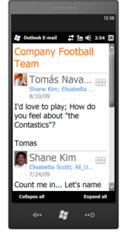
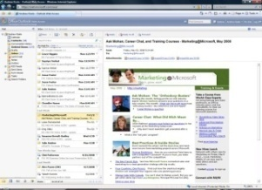

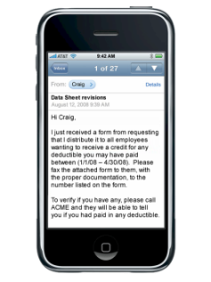
Anywhere Access
Business-Class Messaging
Rich client access via Outlook
Premium web email experience via OWA
Support for a broad range of mobile devices*
Large mailbox sizes (25GB)
Calendaring
Email
Contacts
Tasks
Company Directory
Mobility
Offline Access
PCs
Browsers
Phones
*Access from mobile devices depends on WiFi capability or mobile network availability.
Notes:
Situation
If employees have to learn new user interfaces and change their work practices as part of a move to the cloud, the result would be dissatisfaction and higher support costs. However, because Exchange Online allows users to continue to work as they do now, you have the freedom to “swap out” your back-end infrastructure with minimal disruption.
Slide objective
Show how Exchange Online enables users to work just as they would with on-premises Exchange.
Talking points
Anywhere access means that users can connect to their mailbox with a consistent experience across PC, web, and mobile.
Exchange Online provides a full-featured Outlook experience without the need for a VPN connection, including features in cached mode such as the offline address book.
Outlook Web Access provides a premium online access experience that matches the look and feel of the full Outlook client.
Mobile access is available from a wide range of devices that connect directly to Exchange via the ActiveSync protocol.
Large 25GB mailboxes mean that users don’t waste time cleaning out their mailboxes to make space, or moving email to offline PST files that can’t be accessed from web browsers or mobile devices. All their email data is available to them, wherever they go.

Slide 45
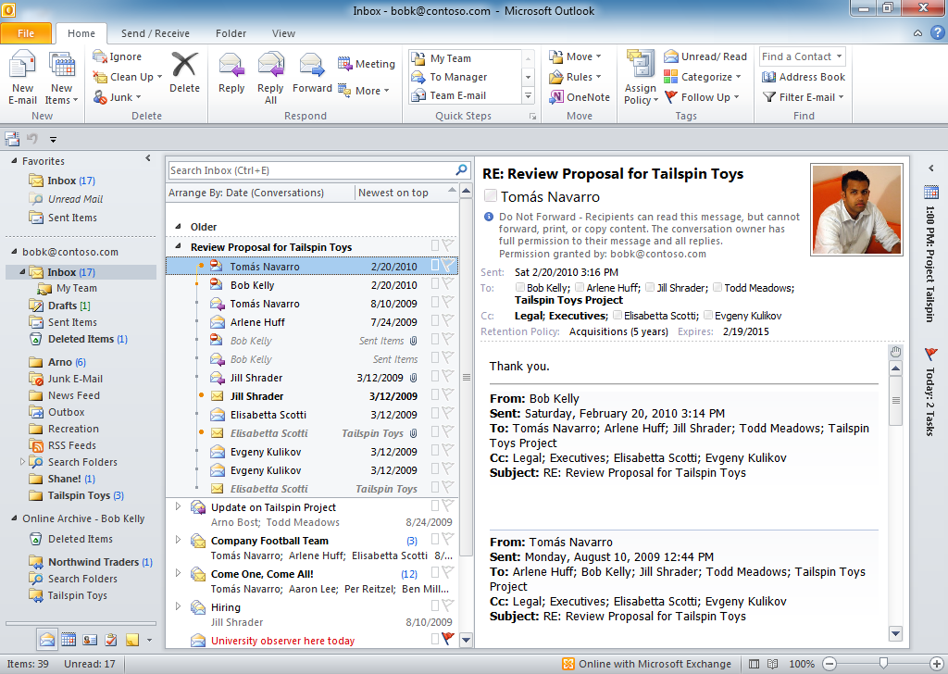
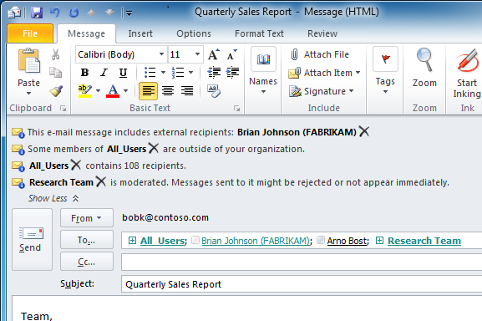
Anywhere Access
Outlook Experience
Gives users a familiar, full-fidelity Outlook experience
Supports Outlook 2010 features including Conversation view, MailTips, and Meeting Room Finder
  Conversation View in Outlook 2010
  MailTips in Outlook 2010
Notes:
Exchange Online includes full-featured support for Outlook 2007 and Outlook 2010.
The experience is familiar to your users, so they can work just as they do today
Because Exchange Online is running the latest version of Exchange, the new features in Outlook 2010 that require Exchange 2010 (including Conversation View, MailTips, and Meeting Room finder) are available to help your users be more productive
Key: don’t need Lync client or outlook client to IM with users - this is a god GOOG compete point!

Slide 46
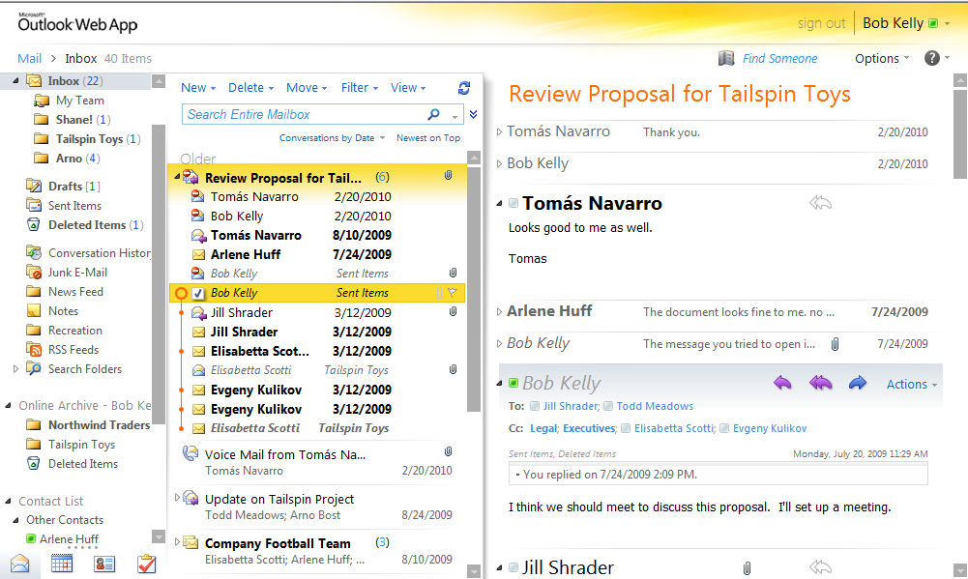
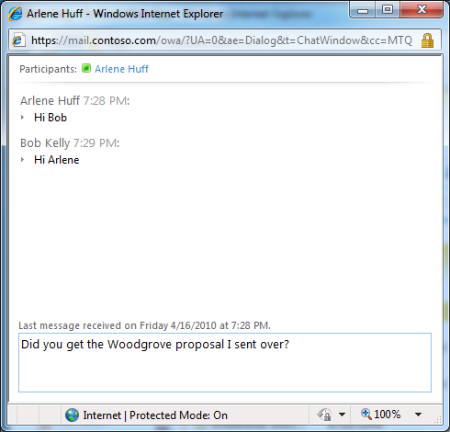
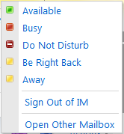
Anywhere Access
Outlook Web App Experience
IE, Firefox, and Safari support
Integrated IM and presence
Enhanced search, filters, favorites
Side-by-side calendar view
  IM and presence integration with Lync Online or Lync Server
Notes:
Outlook Web App (OWA) helps your users be productive from wherever they can log in via a web browser.
The premium OWA experience is available in Internet Explorer, Firefox and Safari
IM and presence integration with Lync Online or Lync Server on-premises lets users chat from right within the OWA experience
Delegate mailbox access has been added
Search had been enhanced, as well as filters and favorites so you can manage your mail more easily
You can view two calendars side-by-side in OWA
The nickname cache is shared between OWA and Windows mobile, so the names of people you frequently email will appear in a drop down list when you create new messages in either place
a good experience if you use OWA internally – Lync is integrated – good for Google compete. don’t need Lync client to im with users in office 365.

Slide 47

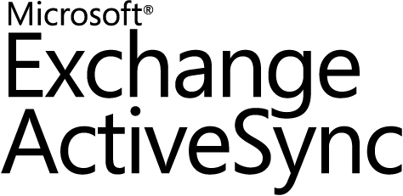

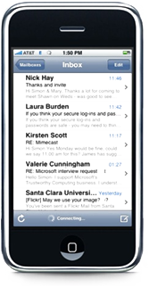

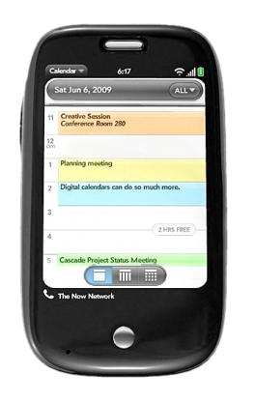
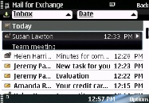
Anywhere Access
Mobile Messaging
Seamless mobile access through Exchange ActiveSync®
Support for popular mobile devices
Self-service remote device wipe
Hosted Blackberry service also available*
Windows® Phone
Apple
Palm/HP
Nokia
Notes:
Exchange Online supports the Microsoft Exchange ActiveSync protocol. Exchange ActiveSync provides synchronization of mailbox data between mobile phones and Exchange Online, so users can access their email, calendar, contacts, and tasks on the go.
Exchange ActiveSync is supported by a wide range of mobile devices, including Microsoft Windows Mobile® and Windows Phone, Nokia E and N series devices, Palm devices, Apple iPhone and iPad, and certain Android phones. Implementation of the specific features of Exchange ActiveSync varies by device and manufacturer.
With Exchange ActiveSync, you can enforce security policies, such as PIN lock, on the devices that connect to your Exchange Online environment. In the event that a mobile device is lost or stole, users or administrators can remotely wipe the device back to its factory settings, from OWA.
You can also control which phones can connect to Exchange Online by creating block/allow lists. Using a Web-based interface, you can create approved device lists for their organization as well as block any particular device they believe should not be allowed. You can also set exceptions at the individual level. Any devices not listed in the block or allow lists can be quarantined, enabling administrators to decide later if they should be allowed to connect. A customizable quarantine email allows administrators to explain to users why their device has been quarantined.
A Hosted Blackberry service is also available as an add-on.
End of CY will most likely be when we have a BB story. Initially we thought this was going to be a lot bigger deal, but customers aren’t really that concerned now that RIM is showing some signs of weakness. customers who never would consider giving up BB are not so disinterested now….Android, iPhone, Win7 phones are good and customers are realizing that RIM is really behind in so many categories. BB laid off 2000 workers on 7/25/11. Not looking good.

Slide 48
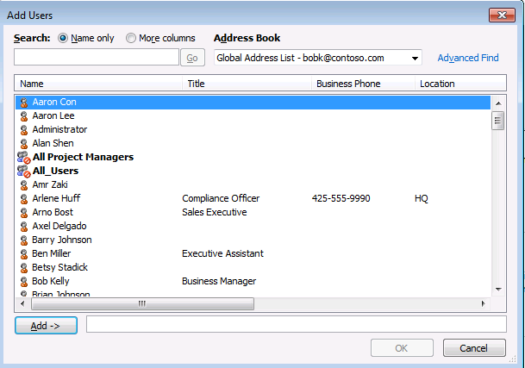
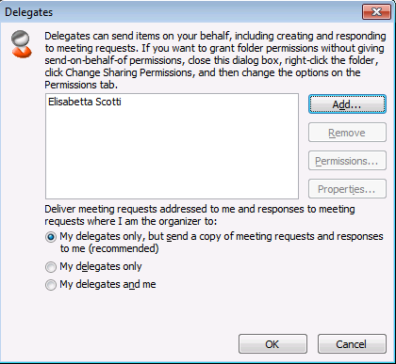
Anywhere Access
Robust Collaboration Features
Global address list and
shared contacts
Shared mailboxes
(for example, sales@contoso.com)
Delegation
(manage another user’s calendar)
Restricted, moderated, and
dynamic distribution groups
  Delegate access
  Global Address List
  Distribution groups
Notes:
Situation
The ability to collaborate effectively can provide companies with a competitive advantage.
Slide objective
Show that Exchange Online provides the powerful and familiar collaboration features that Exchange Server is known for
Talking points
Collaboration features in Exchange Online include:
The Global Address List, or company directory.
Group management capabilities, like personal distribution lists and shared distribution lists.
Shared contacts, for people like consultants and contactors who don’t have mailboxes on your system, but still need to appear in your global address list.
Support for shared mailboxes, which allows multiple people to connect to a mailbox (like help@contoso.com) and send messages with the identity of that mailbox
Support for delegate access to mailboxes and calendars, which is essential for executive assistants and others who manage shared resources.
Distribution groups, including advanced capabilities like restricting who can send to a large distribution group, moderation of messages that are sent to a distribution group, and dynamic distribution groups.
key on this slide: this is full fledged Exchange. It’s not Hotmail with prettiness wrapped around it. this experience is much better than Google.

Slide 49
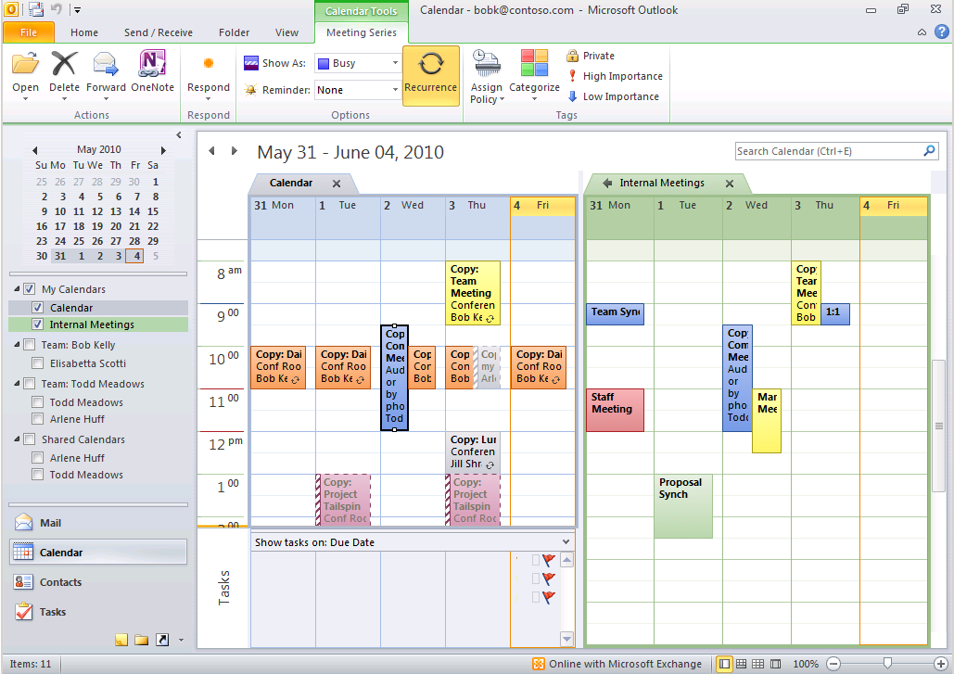
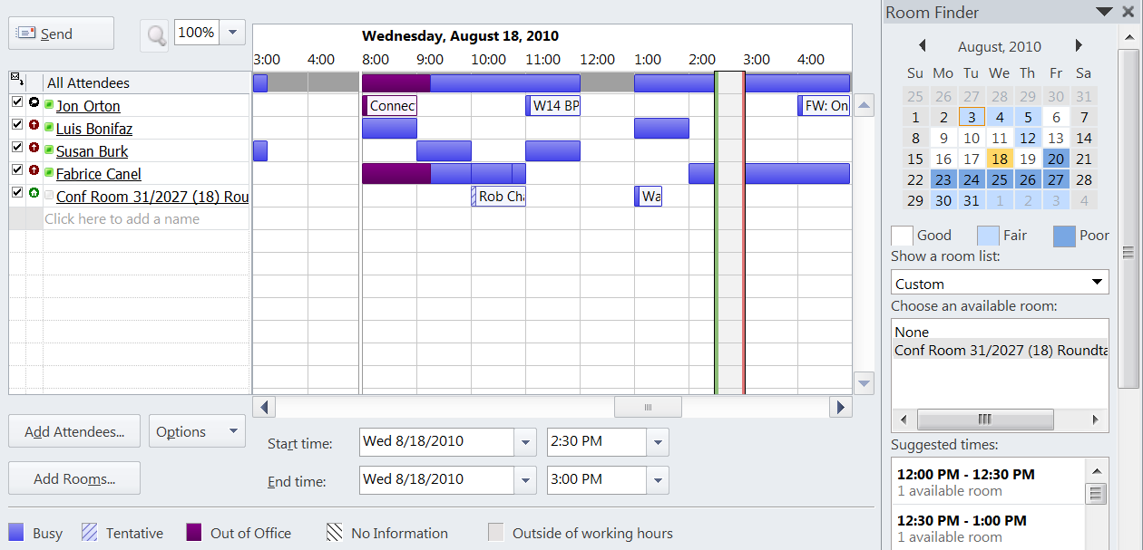
Anywhere Access
Enterprise-Class Calendaring
Calendar sharing
and publishing
Granular calendar permissions
Resource mailboxes (conference rooms)
Out of Office
  Multiple calendars
  Scheduling Assistant
Notes:
Exchange Online provides the same shared calendaring features as Exchange Server 2010 SP1. These include:
Free/busy sharing between users in your organization, with the option for users adjust calendar permissions to share details of their calendars with others.
Organization-to-organization federated free/busy sharing; so you can share free busy data with trusted business partners (the other organization must be running Exchange 2010 or be hosted on Exchange Online or Outlook Live for Live@edu).
The ability for individual users to publish calendars via the iCal standard to users outside of your organization, and subscribe to calendars published in the iCal format.
Conference room support, with a resource booking attendant that can automatically accept or decline meeting requests. These conference rooms come as part of the service, and do not require separate licenses.
Out of Office auto-responses, including the ability to schedule separate internal and external OOF messages, and to schedule OOF messages in advance.
In general, our calendaring is vastly superior to Google. Some people think Google reinvented the world.

Slide 50
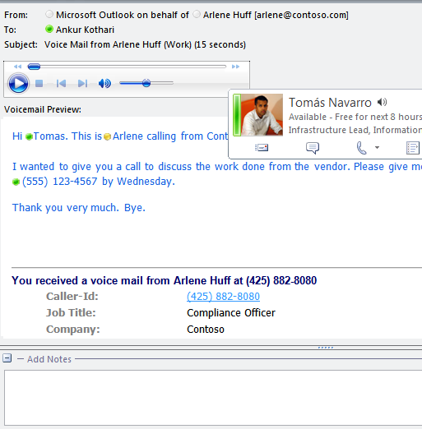
Anywhere Access
Hosted Voice Mail*
Integrates with the on-premises phone system
Removes the need to manage voice mail infrastructure
Gives users a single inbox for email and voice mail
Provides the latest features of Exchange Unified Messaging
  Inline player
  Voice mail preview
  Caller ID
*Hosted voice mail not available in all regions during Beta
Notes:
Exchange Online provides hosted unified messaging and voice mail services. Organizations can connect their on-premises PBX phone systems to cloud-based voice mail services provided by Exchange Online, using simple, Internet-based network connectivity.
That’s a win for the IT department, because it allows them to take advantage of the efficiency and cost-savings that come from a centralized voicemail infrastructure, retiring legacy voicemail systems that are expensive to maintain and back up. That’s also a win for users, because it gives users a single inbox for both e-mail and voice mail messages, which could be accessed from Outlook, Outlook web access, mobile devices, and even a standard telephone through Outlook Voice Access. And, Exchange 2010 adds new features to the core capabilities of Exchange UM, like text preview of voicemail messages, personal auto attendant capabilities, and message waiting indicator.
The new features that Exchange 2010 added to the Exchange 2007-based UM are also available in a cloud environment, including a text preview of voicemails messages, personal auto-attendant capabilities via call answering rules, RMS-protection of voicemails, and MWI interoperability with PBX systems.
Note: we support hosted voice mail through UM – in the cloud today. Regardless of what phone system customers have today on premise. don’t need to be Lync on prep to work. in some cases, Centrex systems, may need to talk to UC specialist. We’ll most likely support it as we support 90% of the scenarios. If traditional on-prem phone system….and the customer is ready to invest in a $1500 gateway, then there’s probably a method to support. nearly everyone today. doesn’t require they have a VoIP already.
This is a far cry from Enterprise voice however, but we will be incorporating technology from find me/follow me functionality built into voice, but it’s not enterprise voice. Ex: for customers who have 30-50 users and no enterprise PBX today – we’ll be able to enable emulate enterprise voice (like Google does). I register this phone number and it forwards to me. Ultimately it needs to be a phone behind that. ex: Mayor, map my work to a cell phone. that’s like Google voice does but it does do emulation.
With the Skype acquisition – already subject to those regulations as a Telco?
E4 solution only if customer wants on-premise voice and o365…it’s a way to license back in b/c it gives them on-prem licensing and not taking voice licensing to the cloud. sometimes having fully featured SKU’s give you features you haven’t thought of….if they’re really going to do voice.

Slide 51
Protection and Compliance

Slide 52



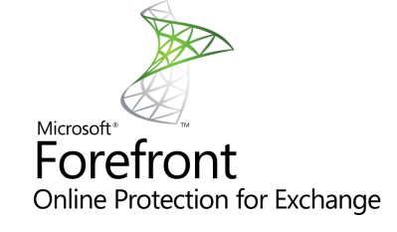



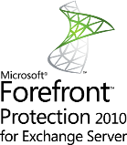
Protection and Compliance
Premium Anti-Spam and Antivirus Protection
External Email
High-accuracy spam filtering
Multiple virus-scanning engines
Included with Exchange Online subscription
Admin center provides advanced policy rules and reporting
Notes:
Situation
Organizations need robust antivirus and anti-spam solutions in place, to keep their users from being burdened with malicious messages.
Slide objective
Describe the enterprise-class anti-spam and antivirus capabilities of Forefront that are built into the service and require minimal effort for the administrator to configure and maintain.
Talking points
Forefront Online Protection for Exchange is included as part of the Exchange Online subscription, to help block malware from reaching your users’ inboxes. This is an enterprise-class antivirus and anti-spam service.
The service uses proprietary anti-spam technology to achieve high accuracy rates.
Forefront uses multiple and complementary anti-virus engines help catch e-mail-borne viruses and other malicious code.
It covers both incoming, outgoing, and internal e-mail messages. This helps protect your organization from malicious content that originates from behind your firewall.
All of this is built-in to your service. No configuration is necessary to start or maintain the filtering technology.
All hygiene pieces with messaging is now included in Exchange Online. looking at cost analysis – Symantec, brightmail, baracuda, etc…all have regular maintenance contracts. All server based AV/AS can go away. Still need client side: Know that in some large environments – AV can be 100K+$ can be a significant % of overall charges. Some customers spend more on hygiene than they do on Exchange.

Slide 53
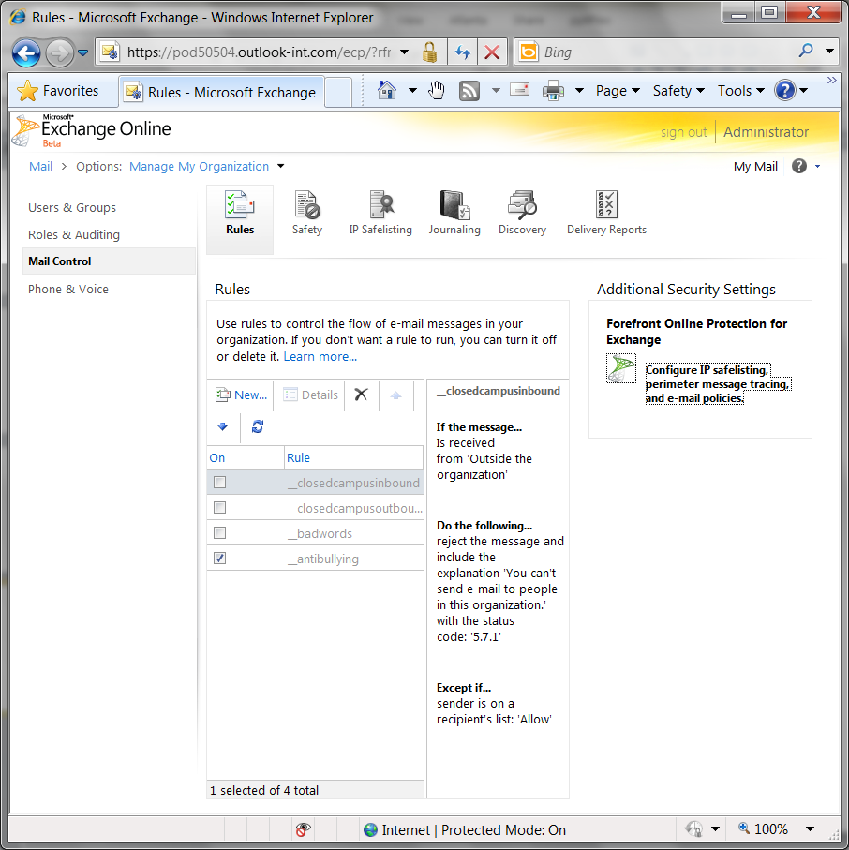
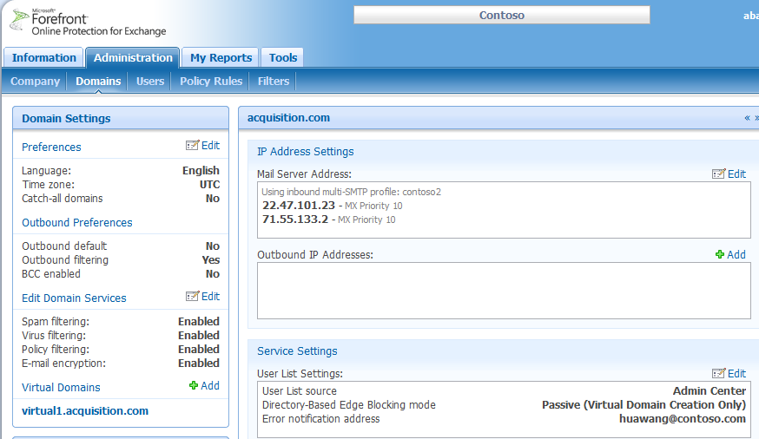
Forefront Online Protection for Exchange Admin Center
Single Sign On from Exchange Control Panel
  Real-time spam filtering and virus detection reports
  Direct access to Forefront Online Protection for Exchange console from Exchange Control Panel
  Customize
  pre-configured
  anti-spam settings
Notes:
Situation
The new Forefront Protection 2010 for Exchange administrator console provides an at-a-glance view of all messaging security detection statistics and health data.
Talking points
Access to Forefront Online Protection for Exchange admin center provides advanced tools and reports:
Detailed reporting – Real time reporting gives administrators insight into their email environment by retrieving the status of any email processed by Forefront Online Protection for Exchange in real-time.
Policy filtering – helps administrators enforce policies they set up to comply with corporate policies on email usage and with government regulations.
Forced TLS – enables administrators to easily create a Forced TLS rule in the policy filter to help ensure that sensitive email is encrypted in transport.
Message tracing – integrated with Delivery Reporting in Exchange Online
* If customer has looked at this before, more full functionality as opposed to dumb down version of BPOS. Better more integrated management environment!

Slide 54
Anti-Spam/Anti-Malware
Summary of Office 365 Changes
Feature | BPOS | Office 365
Personal block sender list | Not available | Configured in Outlook
Personal safe sender list | Not available | Configured in Outlook
Organization-wide safe/blocked senders | Managed in Microsoft Online Admin Center | Managed in Forefront Online Protection for Exchange Admin center
Where does suspected spam go? | Forefront Online Protection for Exchange quarantine | Outlook junk mail folder or Quarantine Folder
Spam quarantine notifications | Every three days | Configurable
Organization-wide IP Safe Listing | Managed in Microsoft Online Admin Center | Managed in Forefront Online Protection for Exchange Admin Center
Granular Anti-Spam Settings | Not available | Managed in Forefront Online Protection for Exchange Admin Center

Slide 55
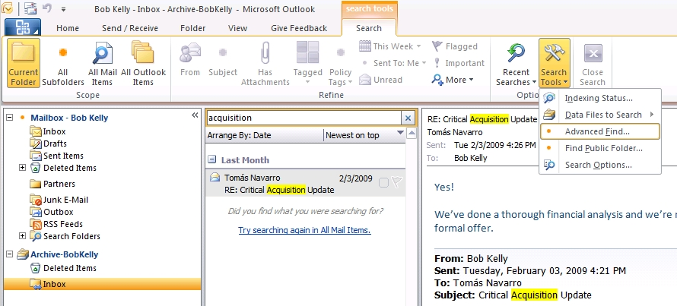
Protection and Compliance
Native Exchange Archiving
Allows easy migration to a managed archive solution
User experience for managing mailbox does not change
Provides a way to centralize data currently stored in .pst files
  Archive can be searched with familiar tools
  Archive appears alongside a user’s primary mailbox
  Content can be dragged from .pst files to the archive
Notes:
Situation :
One of the key challenges relating to compliance is how to centrally manage and control all email data, including PSTs residing on user’s desktops. Unlike mail stored on the server, PSTs on individual desktops cannot be easily and quickly discovered; litigation holds and corporate expiration policies cannot be enforced. Meanwhile, from the IWs perspective, managing PST quotas can be frustrating, including diminishing Outlook performance as PST folders grow. Move PSTs to a network share and a new set of problems arise: increased PST corruptions and a degraded search experience.
Feature Talking Points
With the introduction of a native archiving feature in Exchange Online, customers can move easily from an unmanaged to a managed solution
The “archive” is a separate mailbox, managed and controlled by the administrator
Users can drag and drop PSTs to an archive folder within their inbox or schedule auto-move of messages to archive through Folder or Item policy tags
PSTs are now discoverable; legal holds can be easily applied and performance is not compromised for large mailboxes (10-100 GB)
The mailbox experience does not change within the archive: users can view, read, and navigate mail the same as today
Slide Objective – The audience should walk away understanding that the new Exchange archive feature offers a simple way to centrally store and manage PSTs – while maintaining the familiar mailbox management experience for users.
Every single customer should have this slide – Exchange Online customers. Our capabilities kick Google’s butt here! We have a MUCH better experience. Google is a collection of bolted together products to make Gmail. This shows that our solution is built on top of Exchange and not cobbled together. Support for legal hold, multi mailbox search, etc…
Even with EP1 – you can get multi-mailbox search. Need EP2 for vmail, legal hold, indelible rolling windows (set a policy that you cannot delete mail for 7 years), unlimited mailbox size. E-discovery works in EP1, which is a huge improvement over BPOS!!!! couldn’t search multiple mailboxes in BPOS.

Slide 56
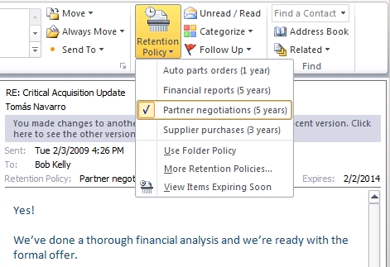
Protection and Compliance
Retention Policies and Legal Hold
Custom policies automatically delete or archive content
Integrates with personal archive
Legal hold policy captures user edits and deletions
  Policies apply to all emails within a folder by default
  User can select retention policy for a specific email
  User can view expiration date
Notes:
Situation :
The explosive growth of regulatory compliance and corporate governance requirements has made it challenging for email administrators and compliance officers to provide end users with simple tools for managing retention policies of the high volume of e-mail messages being sent and received daily. It is impractical for a small group of people to police e-mail to this end directly, so tools which enable end users to apply retention policies which are defined by the organization and tools which automatically apply such policies without IT intervention are required to effectively mitigate the risk associated with compliance and governance.
Talking Points:
Retention policies can be applied to any individual e-mail or folder rather than just a restricted set of managed folders
Policies are defined centrally and pushed to the client, exposed directly to users in the UI for selection or notification
These policies have great integration with the archiving features from the last slide.
Transport rules can be designed to automatically apply default policies for select groups of users or based on select attributes of e-mail
You can use legal hold to preserve all mailbox content for certain users or your entire organization, so that a copy of every message is retained for compliance reasons. Deleted messages are hidden from the users’ view, but they are still searchable via Exchange’s multi-mailbox search tools.

Slide 57
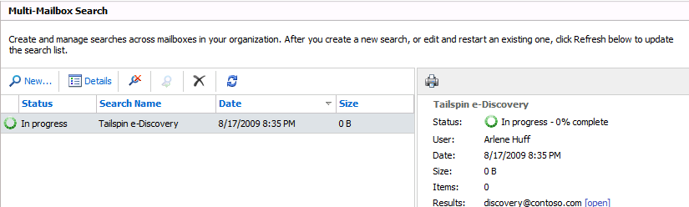
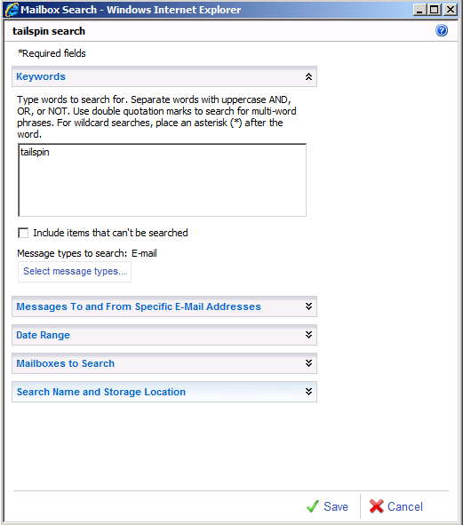
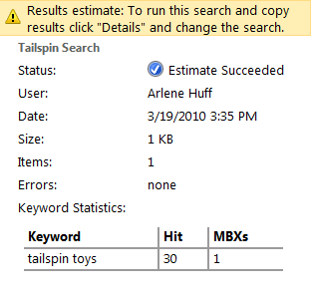
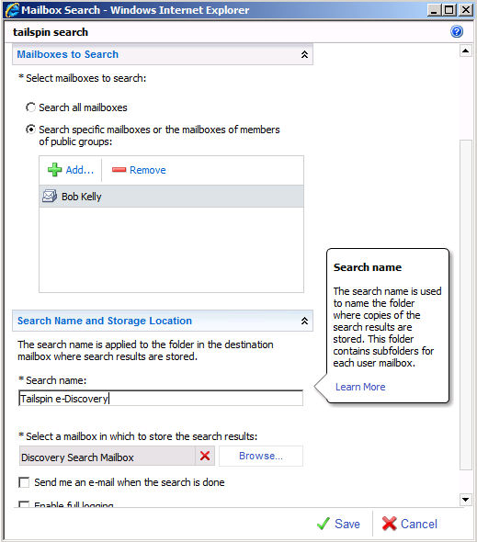
Protection and Compliance
Multi-Mailbox Search
Web-based search capabilities can be delegated to specialists
Empowers legal and compliance staff to conduct e-discovery
Search works across on-premises and online mailboxes
  Preview of search results
  Rich search criteria
  and targeting options
  Results stored in specialized mailbox
Notes:
Situation:
Traditional e-mail systems require complex access control policies and provide hard to use tools in order to meet the growing needs of eDiscovery and requirements of Human Resources departments relative to searching corporate communication throughout the e-mail infrastructure. Those responsible for these tasks are non-IT users who are unfamiliar with e-mail administration tools and do not have access to the e-mail servers. These compliance officers and HR representatives are having to follow complex processes and use complex tools, aided by IT, to handle what is already a complex problem due to legal and corporate governance. Solutions are required which empower these individuals to go about their business without IT intervention and which ensure that only those assigned by the organization to perform such tasks are able to.
Talking Points:
Cross-mailbox search user interface enables compliance officers and HR to perform searches based on select e-mail attributes across the entire mail infrastructure
Roles-based administration allows for easy delegated access to this tool with no complex Access Control Requirements
eDiscovery processes may be followed without IT intervention and only by those authorized
Compliance officers and HR representatives use familiar and easy-to-use tools within the existing UI of Outlook and Outlook Web Access
Slide Objective:
The audience should see that Exchange goes beyond traditional administration models to empower delegation of tasks associated with compliance away from the email administrator and put these tasks into the hands of those responsible with easy-to-use tools

Slide 58
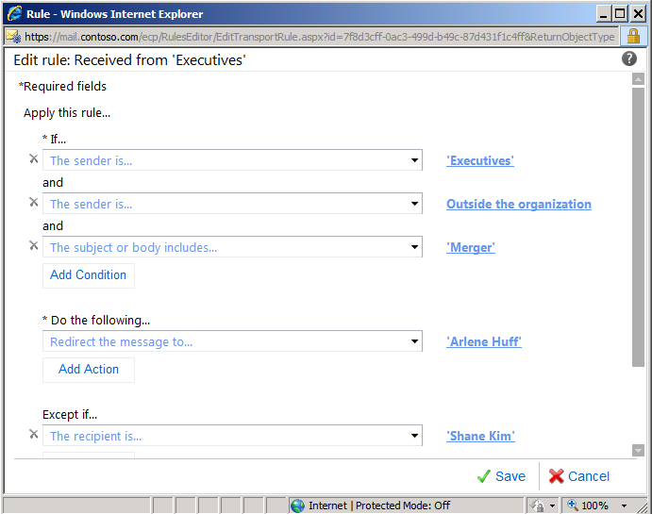
Protection and Compliance
Transport Rules
If the message
is from a member of the group ‘Executives’
and is sent to recipients that are 'Outside the organization' And contains the keyword ‘Merger’
  Conditions
  Actions
Do the following:
Redirect message to arleneh@contoso.com
  Exceptions
Except if the message
is sent to shanek@contoso.com
Structured like inbox rules
Apply to all messages sent inside and outside the organization
Configured with simple Web-based GUI
Notes:
Situation
Understanding transport rules is important to understanding how IPC works in Exchange.
Slide objective
Explain how transport rules are configured.
Talking Points
Exchange Online supports transport rules. Transport rules inspect every piece of mail that flows through your Exchange Online environment. Even email from one mailbox to another mailbox in the same server goes through the transport server role.
Transport rules are configured just like Outlook rules using a simple GUI to apply conditions, actions and exceptions:
Conditions identify specific criteria such as sender, receiver and keywords within a message.
Actions are applied to email messages that match these conditions.
Exceptions identify messages to which a transport rule action shouldn't be applied, even if the message matches a transport rule condition.
Transport rules are flexible: Scan for specific keywords or regular expressions such as social security numbers; create ethical walls that block mail between specific users; automatically modify messages with disclaimers…
Over 50 conditions and actions can be selected to create a rule

Slide 59



Protection and Compliance
Integration with IRM Services
AD RMS Server
(On-premises)
Exchange Online
Key Import
Exchange Online can be integrated with on-premises AD RMS
This activates advanced Exchange 2010 IRM features, including:
IRM in OWA, IRM search, and protected voice mail
Transport Protection Rules and Outlook Protection Rules
Notes:
Situation
Exchange 2010 offers advanced AD RMS integration, and customers who run RMS servers on-premises want to know if they can get these features by integrating the RMS server with Exchange Online.
Slide objective
Explain how customers can use leverage their AD RMS cluster on premises to leverage IRM support features in Exchange Online. (transport protection rules, IRM in OWA, etc.)
Talking points
[Build 1] Tenant must import a Trusted Publishing Domain from their AD RMS cluster into Exchange Online.*
Exchange Online tenants get all IRM capabilities, except for Pre-licensing
Keys stored securely via Distributed Key Management (DKM) within Datacenter and only accessible to Exchange Service
After setup, all RMS transactions in Datacenter executed within Datacenter
*To configure: On RMS cluster, go to Trusted Publishing domain; Export to XML file; Run import-rms trustedpublishingdomain; Configure what RMS drop down you want to appear.
The XML file contains the RMS private key, the currently defined RMS templates, and data about the RMS cluster.
Today: not supported, but RMS server on AD server on prem. A lot of action at Tech Ready – EHE and IRM merged into single product. This fiscal year. Encrypt messages at rest – IRM is an answer to that.
NOTE: Exchange is not required to send/receive IRM-protected messages in Outlook. Therefore, no TPD Import is required if you only need to send/receive IRM protected messages in Outlook (and have no need for advanced features like IRM in OWA or transport protection rules.
In the cloud, we cannot do IRM. We do however integrate with it. On-prem IRM installed on premise. Exchange hosted encryption and IRM will be merged into a single product. we’ll have a better solution in the near future on this. this fiscal year! if customer needs to encrypt messages at rest, IRM is the solution to this.

Slide 60



Protection and Compliance
Flexible Mail Routing
  Internet
Outbound email
Route outbound email messages through on-premises email server or other hosted service
Allows use of third-party appliances for encryption and data leakage prevention (DLP)
  Messaging Server or Appliance
Notes:
Situation
Some customers may want to route mail to specialized appliances on premises.
Slide objective
Explain how FOPE Connectors enable custom outbound email routing.
Talking points
Outbound email can be securely routed through on-premises gateway
Additional processing can be performed on outbound mail (address rewrite, encryption appliances, etc.)
One-way routing
FOPE Connectors can be configured in the Admin Console for SmartHost Routing of outbound mail
FOPE Admin Console can also enable Forced TLS for secure traffic channel
Option to check for valid certificate and domain from destination for additional protection
Two-way routing
Customer may want intra-organizational routing of mail (for example, to use a DLP appliance)
FOPE Connectors can be used in conjunction with Tenant Mail Control in Exchange 2010 SPI for bi-directional internal routing

Slide 61
Visibility and Control

Slide 62
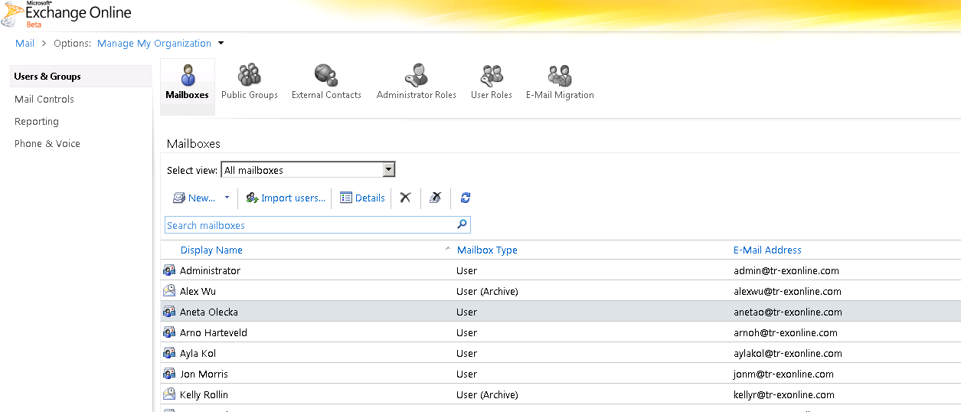
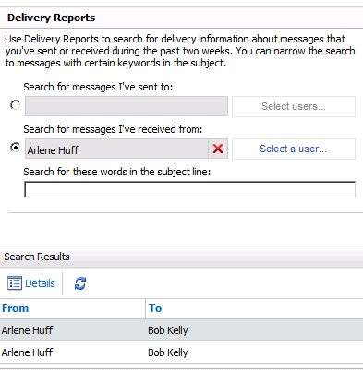
Visibility and Control
Exchange Control Panel
Powerful web-based tool for managing the online environment
Capabilities such as multi-mailbox search and group management can be delegated to non-IT users
Notes:
Powerful web-based management capabilities introduced in Exchange 2010, called the Exchange Control Panel, augment the capabilities of the Microsoft Online Portal giving you the ability to:
Search delivery reports to help troubleshoot message delivery issues
Configure many types of resource mailboxes, not just conference rooms
Access the “mail settings” screens in OWA on behalf of a user, to help troubleshoot issues for them (very useful for help desk personnel).
Manage many other capabilities shown previously in this presentation, like transport rules, journaling, UM settings, and multi-mailbox search
These new administration capabilities are web-based and controlled via the new Role Based Access Control (RBAC) capabilities in Exchange 2010, so they can be delegated to non-IT users. These non-IT business specialists can access these screens directly from OWA or Outlook, based on their Exchange Online credentials.
If customers looked at BPOS, we’re a lot better now – we’ve made a ton of management improvements. More visibility/control.
Role delegation
Cities with public safety and public safety wants to handle their own stuff. Next to impossible before, now it’s very easy to control.

Slide 63



Visibility and Control
Remote PowerShell
Allows scripting and automation of routine tasks
Permits updated settings without calling support
Gives access to raw data for reports
New-DynamicDistributionGroup
  -Name "Florida Sales and Marketing"
  -IncludedRecipients MailboxUsers
  -ConditionalDepartment Sales, Marketing
  -ConditionalStateOrProvince Florida
Notes:
PowerShell is the way we provide support for repetitive tasks. And chances are good that there is a PowerShell script already written to do 80% of what they want to do.
PowerShell has become a common way to manage the latest generation of Microsoft Server products, including Windows Server 2008, Exchange Server 2007, and Exchange Server 2010. With Exchange Online, PowerShell becomes another item your adminstrative toolbox, giving you greater control over the Online environment.
You use Windows PowerShell on a local computer to connect to your Exchange Online organization and perform management tasks that aren't available or practical in the Web management interface. You just install Windows PowerShell on your client machine, and you are off and running. Like EMC, Remote PowerShell connects to the datacenter using standard protocols to allow easier management through firewalls.
RBAC integration means you can delegate PowerShell management capabilities in a scoped way within your IT org. The datacenter is effectively delegating permission to you to manage aspects of your hosted Exchange forest, without giving you permission to manage things like back-end databases. You can further delegate specific abilities within your org.
Remote PowerShell is useful for creating scripts to automate routine tasks, and for batch processing. For example, you can create or update many user accounts at one time.
You use the same commands and syntax as PowerShell administration for other Windows Server products on-premises, so the time invested in building PowerShell skills pays dividends in both the Online and on-premises worlds.
Another example:
To allow users to set up inbox rules to enable server-side forwarding, and automatic reply messages (these are off by default today), you could run this command:
set-remotedomain -AutoReplyEnabled true -AutoForwardEnabled true

Slide 64



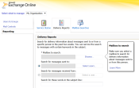

Visibility and Control
Role Based Access Control
Andy Ryan
Systems Administrator
Joanna Rybka
Tier 1 Support (Public Safety)
Donna Scott
Compliance Officer
Organization Management
Help Desk
Discovery Management
Create users
Edit retention policies
Create transport rules
Configure UM
Set legal hold
Edit mobile security policies
Manage dynamic distribution lists
Track messages
View-only recipients
Mobile device wipe
Manage groups
Multi-mailbox search
Set legal hold
All employees
All employees in Public Safety
All employees in the Exec Branch.
Delegate administrative tasks within IT and beyond
Granular control over scope and permissions
Notes:
New Role-Based Access Controls (RBAC) in Exchange Online give you the ability to delegate administrative tasks within your IT org, as well as to end-users in your organization.
These RBAC controls apply whether you are managing the environment via the web-based Exchange Control Panel interface, Remote PowerShell, or the Exchange Management Console (in cross-premises coexistence).
In the examples shown here, you might use RBAC to give a systems administrator complete control over your Exchange Online environment, while giving Tier 1 support staff a more limited set of capabilities, scoped only to the users in Europe. You could also give a compliance officer self-service capabilities to conduct multi-mailbox searches.
Delegating tasks is now much easier – customers can designate an uber admin, tier 1 support, 1 agency vs. another
Can now also have a compliance officer who can do e-discovery.
Google – no where near as flexible as our RBAC. They do have some capabilities. when it comes to E-discovery, it’s way more limited. The Tier 2-3 helpdesk scenarios, they don’t have as much flexibility.

Slide 65
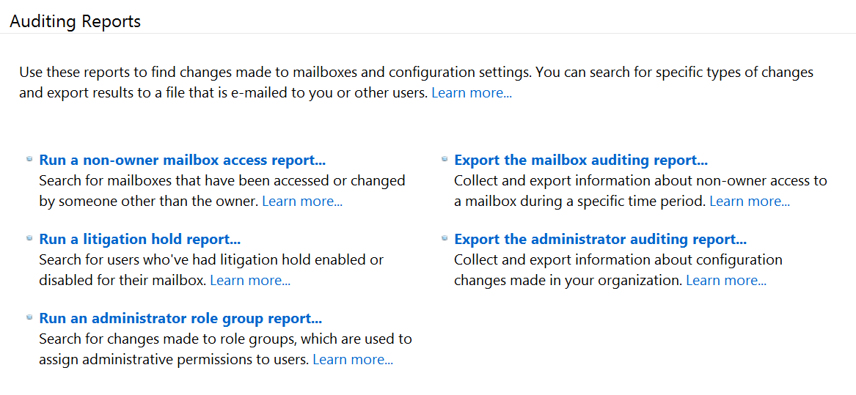
Visibility and Control
Auditing Reports
  Export log data for
  long-term retention
  or custom reports
  Track mailbox access: delegates, shared mailboxes
  Track configuration changes: RBAC, settings
Track delegate access and see which users have logged in to shared mailboxes
Find out who changed configuration settings and administrative permissions
Extract data in XML format for long-term storage or to build custom reports
Notes:
Many people ask: Does Exchange Online have the ability to provide granular reporting on who accessed what mailbox when? The answer is “yes.”
Administrators can run reports to see:
Access to mailboxes by users other than the owner. This data is useful for tracking access by multiple users to shared mailboxes. It also can be used to track access when a person (such as an executive) delegates permission to their mailbox to an assistant
Changes to litigation hold status. This allows you to see who was put on litigation hold (or taken off litigation hold) to verify compliance with requirements to preserve information when a lawsuit is filed.
Changes to administrative roles and groups. If an administrator changes roles and gains broader permissions, you can see it in this report.
Changes to other configuration settings. This allows you to track a variety of configuration settings made to your online environment by your administrators.
Pre-written auditing reports!!! Show me everyone who wasn’t a mailbox owner who tried to access a mailbox. show me those on litigation hold! Show me everyone when mailboxes were accessed and when. Canned reports and can be delivered into other reporting systems too. these were the most commonly used customer reports.

Slide 66
Deployment Flexibility

Slide 67
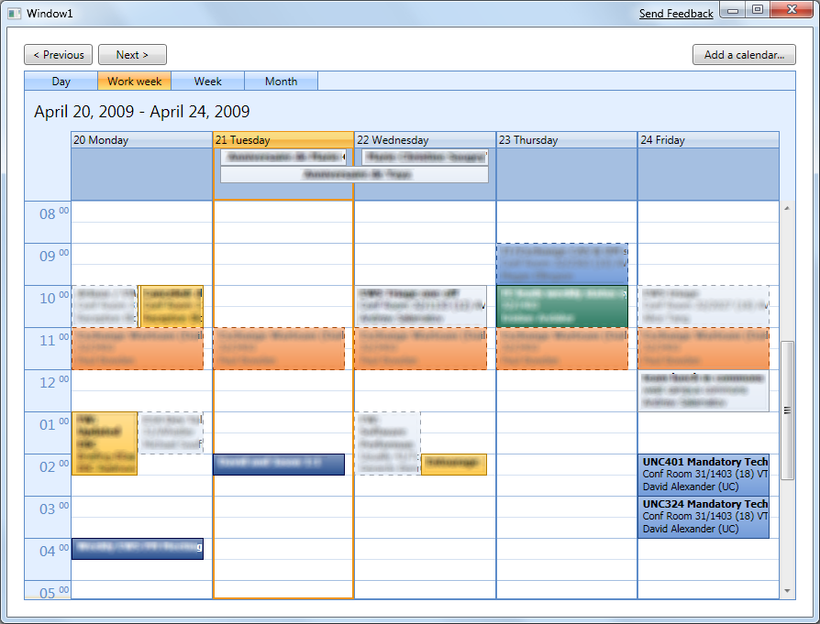

Deployment Flexibility
Exchange Web Services
  Flexible
  Works with Exchange Online
  Works with Exchange Server
  Works in hybrid environments
  Easy to Use
  .NET-based EWS Managed API 1.0
  Full support for Microsoft Visual Studio®
  Rich Functionality
  Create custom portals and applications
  Enhance line of business apps with
  calendar data and email workflow
Notes:
Exchange Online supports Exchange Web Services (EWS). EWS is a unified API for accessing Exchange mailbox data that has existed since Exchange 2007 and the original launch of Exchange Online.
EWS offers three main benefits:
It is the richest, most functional, and most versatile API for Exchange. It supports all new features Exchange Server 2007 and 2010 offers. The one API can be used in the various application models: you can build the Exchange information into your own client application, you can mash Exchange information into your Web portals, or you can even use Exchange data into your processes.
Examples of the first are Entourage for the Mac or Apple’s iMail in Snow Leopard. Or the display of free/busy information in Lync 2010, or how Communicator can store conversations into your Conversation folder in Exchange.
Examples of the second are Webparts, like used in SharePoint or Dynamics CRM, or various University portals of Live@Edu.
Examples of the third are Google using EWS to synchronize the contact list with their Android based mobile phones, or the displays Microsoft conference rooms have showing who has reserved such conference room. Also Dynamics uses EWS to sync its data with Exchange Server 2010.
It is easy to use, for any Visual Studio developer will feel familiar with the two major programming paradigms supported:
Web Services
.NET.
In Exchange Server 2010 we have added a full implementation of the EWS API in Managed code, supporting .NET 3.5 SP1. Using this API increases productivity tremendously for you need less lines of code and have full support of IntelliSense in Visual Studio, with autocomplete and inline help.
The last benefit is that given Exchange always use Web Services to communicate with the server, even if you implement the application in the EWS Managed API, it is the same code that can be run against an on-prem implementation as well as against an online implementation. Applications can reside locally on the CAS server or can connect via the Intranet or via the Internet.

Slide 68
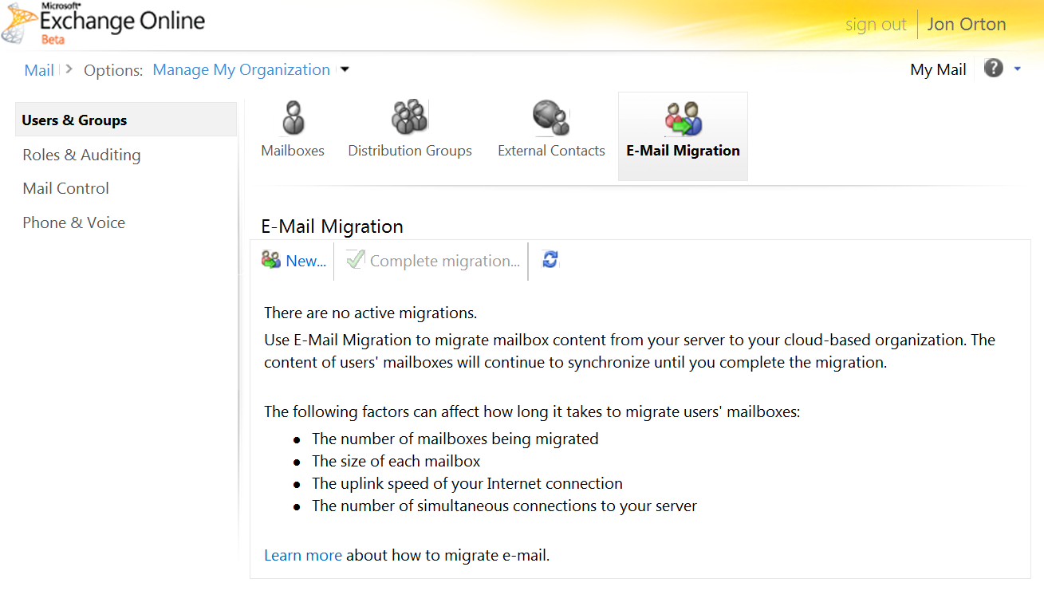
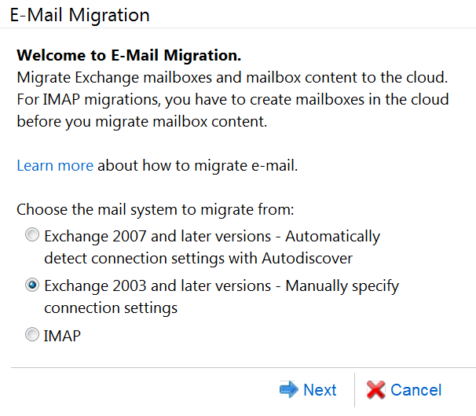
Deployment Flexibility
Web-Based Exchange and IMAP Migration Tools
Free migration tools
No software to install
Migrate email, calendar, contacts and tasks from Exchange Server 2010, 2007, or 2003
Migrate email from
all platforms that support IMAP
Allows fast cutovers
or staged migration
Notes:
Exchange Online provides quick, low-impact options for migrating to the cloud from Exchange Server 2003, Exchange Server 2007, and any messaging system that supports IMAP. These web-based migration tools are designed for customers who want to migrate their on-premise mailboxes into Exchange Online and who do not have advanced requirements like free/busy calendar federation, off-boarding, etc.
Customers can migrate their users and corresponding data from on-premise Exchange servers to Exchange Online with ease and with as little change as possible on their environment, and can do an “all at once” cutover of users to the cloud.
We provide new web based Exchange migration tools – many customers will go this way. No s/w to install, migrate email, contacts, calendars and all goodies that go along with it. Also, we support any software piece that supports IMAP (like GroupWise, sometimes Notes, all Linux freeware, commercial systems, etc…), we’ll support for these migrations.

Slide 69

Deployment Flexibility
Rich Coexistence with Exchange Server
Add an Exchange 2010 server to the on-premises environment
to unlock advanced coexistence features
Exchange 2010 SP1 “gateway” server
Exchange Server 2007 or 2003
Share free/busy data between cloud and on-premises users.
Migrate users to the cloud with native Exchange tools.
Preserves Outlook profile after migration (no OST resynchronization).
Easily return mailboxes on premises.
Notes:
Organizations interested in the smoothest migration experience, or organizations that want to have permanent coexistence, with a mix of some users on-premises, and others in the cloud, would choose rich Exchange coexistence.” In this scenario, an Exchange 2010 SP1 server is deployed on-premises, and acts as a gateway to the cloud (for redundancy purposes, larger organizations will typically deploy 2 servers).
With the Exchange 2010 server in place, administrators can:
Manage both their local Exchange forest, and their Exchange Online forest, from the Exchange Management Console
Move users to the cloud using PowerShell or the Exchange Management Console
Enable seamless calendaring, including free busy and full calendar sharing, between hosted and on-prem users
Configure cross-premises mailflow so that all mail truly looks and feels like it is internal to the company. And, if desired, configure all inbound and outbound mail to flow through the local email servers.
Move mailboxes back on-premises if the need arises
Although an Exchange Server 2010 server is deployed on-premises, there is no need to upgrade mailboxes to Exchange Server 2010 prior to moving them to the cloud. The Exchange Server 2010 server has the ability to act a proxy or bridge, between older Exchange Server 2003/2007 environments and Exchange Online, without the need to migrate on-premises Exchange mailboxes to Exchange Server 2010.
Once an organization reaches 100% of mailboxes in the cloud, they would typically remove the Exchange Server 2010 server. The Directory Sync tool and ADFS server would remain in place so to connect on-premises AD infrastructure to the cloud to power SSO, easy provisioning, and a unified directory.
Note: The Directory Sync tool, and ADFS (Geneva) federation for enterprise single sign-on would also be part of this coexistence story
Let’s take a closer look at the capabilities that light up when a Exchange Server 2010 server is installed on-premises.
Advanced co-existence: some we’ve seen deploy this mainly for ease of migration. Make sure there is 1 Exchange CAL installed. HUB transport role on it and then right click and move from on-prem to the cloud. Migrate from server to server. Pilot to production. Don’t have to recreate OST. Enables with outlook open.

Slide 70

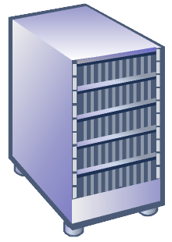
Exchange Online Hybrid Scenarios
Calendar free/busy sharing
Smooth migrations
Unified management
Easy offboarding
Rich coexistence capabilities
Exchange 2010 SP1
Low-risk pilot deployments
Gradual migration over time
Regulatory or legal issues require that some users stay on premises
Mergers and acquisitions
Exchange 2007/20037

Slide 71
Coexistence and Rich Coexistence
Feature | Simple | Rich*
Mail routing between on-premises and cloud (recipients on either side) | ■ | ■
Mail routing with shared namespace (if desired; @company.com on both sides) | ■ | ■
Unified global address list (GAL) | ■ | ■
Free/Busy information and calendar sharing across premises |  | ■
Out of Office notice understands that across-premises is internal to the organization |  | ■
MailTips, messaging tracking, and mailbox search work across premises |  | ■
Outlook Web App Redirection across premises (single URL for Outlook Web App both on premises and in the cloud) |  | ■
Preserve Auth header (that is, ensure internal email is not marked as spam, resolve against GAL) |  | ■
Exchange Management Console on premises is used to manage cross-premises mailbox migrations |  | ■
Mailbox moves support both onboarding and offboarding |  | ■
No Outlook reconfiguration or OST resynchronization required after mailbox migration |  | ■
*Rich Coexistence feature set requires Exchange 2010 SP1 HT+CAS on premises and requires supplemental configuration steps (both on premises and in the cloud)
Notes:
Co-existence: short term: ease in migration scenarios. Most customers in our space could migrate over a weekend. We migrated 900 mailboxes – Arlington county in 1 day. May not have it
If some mailboxes they don’t want to move, but keep 50 on-prem –
Another reason: keep our BB but want to keep our BB. 100 BB and no answer for that, so we’ll leave them on prem (this is common right now)
If you’re not going to live for a long time, don’t go to Rich b/c have to have ADFS implemented. Specific role up and patches on Exchange. Have to access to know what you need, etc…
Our partners are very good at this. Simple or none (flip the switch)
Planet for Arlington: fixed fee. 5000 seats. Sliding scale. 0-1000 costs $x. Over 3k seats costs z.
if customer is doing the simple migration with web based tool – customers could handle on their own if 300 seats for example. If they’re not capable, they can make a big, fat stinking mess very quickly and then a partner has to come in to rescue.

Slide 72
Key Customer Choices
Simple Coexistence
  DirSync synchronizes identities.
  No on-premises Exchange Server 2010 Client Access server exists.
Rich Coexistence
  DirSync synchronizes identities.
  Customer has Exchange Server 2010 Client Access server on premises.
  Customer has enabled rich coexistence features in DirSync.
  DirSync enables some new Exchange rich coexistence features (Filtering Coexistence, Cloud Archive).
      Filtering Coexistence: Is the customer already using an existing filtering solution?
      Cloud Archive
        Enables the on-premises Exchange administrator to specify who receives cloud archives.
        Requires Exchange Server 2010 Client Access server on premises.

Slide 73
Issues….

Slide 74
Exchange Online—What’s Not Available?
Client Access
Outlook 2003 support
Outlook Web App login: public/private buttons
Blackberry application push; advanced settings
Administration
.pst file import and export
Provisioning of users in multiple data centers
Multiple on-premises Active Directory forests
Resource forest topologies
Directory
Hierarchical address book
Global Address List segmentation
Compliance/
Archiving
Managed folders similar to those in Exchange 2007
Graphical user interface for creating retention policies
Multi-mailbox search: export to .pst files
Third-party add-ins for transport rules
Voice mail
Speech-enablement of directory and auto-attendant
Applications/ Developer
MAPI/CDO access
Server-side code, .dlls, transport agents
Custom Outlook Web App themes, logos, add-ins
Public folders
Security
S/MIME in Outlook Web App
S/MIME certificate synchronization

Slide 75
Exchange Online Message Limits
The following limits help protect against spam and malicious users and help prevent overconsumption of resources.
Rule | Limit | Comment
Message Size Limit | 25 MB | Includes attachments. Attachment size can be restricted by policy.
Number of recipients per message | 100 | A distribution list counts as one recipient.
Number of recipients per day per account | 500 | A distribution list counts as one recipient.
Message send rate | 30 per minute | Messages are queued if necessary.
Notes:
Note: There are other limits described at http://help.outlook.com/en-us/beta/140/dd630704.asp

Slide 76






Exchange Server and Exchange Online
Email and
Calendar
Mobile
Collaboration
Voicemail in
Your Inbox
Email
Archiving
  ON-PREMISES
✓
✓
✓
✓
  Office 365
✓
✓
✓
✓

Slide 77
Exchange Server and Exchange Online
Rich client access via Outlook
Premium web experience via OWA
Email and
Calendar
Mobile
Collaboration
Voicemail in
Your Inbox
Email
Archiving
Large mailbox sizes (25 GB)
  ON-PREMISES
✓
✓
✓
✓
Calendar sharing and publishing
Premium antispam and
antivirus (Forefront)
  Office 365
✓
✓
✓
✓
Information protection and control

Slide 78
Exchange Server and Exchange Online
Sync email, contacts, calendar
Supports popular mobile devices
Email and
Calendar
Mobile
Collaboration
Voicemail in
Your Inbox
Email
Archiving
Remote device wipe
  ON-PREMISES
✓
✓
✓
✓
Mobile device security policies
  Office 365
✓
✓
✓
✓
Block and quarantine devices

Slide 79
Exchange Server and Exchange Online
Text preview of voicemail
Customized greetings
and call-transfer options
Email and
Calendar
Mobile
Collaboration
Voicemail in
Your Inbox
Email
Archiving
Voice access to e-mail,
calendar, and contacts
  ON-PREMISES
✓
✓
✓
✓
Message waiting indicator
  Office 365
✓
✓
✓
✓
Lower total cost of ownership with email and voicemail on one platform

Slide 80
Exchange Server and Exchange Online
Personal archive
“Move and delete” policies
Email and
Calendar
Mobile
Collaboration
Voicemail in
Your Inbox
Email
Archiving
Legal hold policies
  ON-PREMISES
✓
✓
✓
✓
Transport rules
  Office 365
✓
✓
✓
✓
Multimailbox search
for eDiscovery

Slide 81





Lync Server and Lync Online
Basic Messaging
Conferencing
Voice
PBX Replace
  ON-PREMISES
✓
✓
✓
✓
  Office 365
✓
✓
FY12
Not Available

Slide 82
Lync Server and Lync Online
Basic Messaging
Conferencing
Voice
PBX Replace
  Presence
  IM
  GAL and skill search
  ON-PREMISES
✓
✓
✓
✓
  Activity feeds
  Windows Live Messenger
  Federation (including Mac)
  Office 365
✓
✓
FY12
Not Available
  PC-to-PC voice and video calls

Slide 83
Lync Server and Lync Online
Basic Messaging
Conferencing
Voice
PBX Replace
  Multiparty (3+) audio/video
  As-needed collaboration
  Application sharing
  ON-PREMISES
✓
✓
  Online meetings
✓
✓
  Reservation-less audio conferencing
  Office 365
✓
✓
FY12
Not Available
  Requires Telco partner to connect
  to the public phone network
  (PSTN audioconferencing)

Slide 84
Lync Server and Lync Online
Basic Messaging
Conferencing
Voice
PBX Replace
  Call landlines and mobiles (PC to PSTN)
  Transferring and forward calls
  Single number
  ON-PREMISES
  Simultaneous ring
✓
✓
✓
✓
  Exchange voice mail integration
  Office 365
✓
✓
FY12
Not Available
  Requires Telco partner to connect
  you to the public phone network
  (DIDs, PSTN termination)

Slide 85
Lync Server and Lync Online
Basic Messaging
Conferencing
Voice
PBX Replace
  E911
  Call admission control
  Branch office appliance
  ON-PREMISES
✓
✓
✓
✓
  Existing telephony integration
  Fax and analog devices
  Office 365
✓
✓
FY12
Not Available
  Call park, hunt groups
  If the customer wants PBX replace, all Lync workloads must run on-premises.
Notes:
On-premises Lync can work with SharePoint and Exchange Online with the Office 365 “E” 4(?) + Voice CAL!

Slide 86
SharePoint and SharePoint Online
Sites and Communities
Content Management
Search, Insights, and Composites
i
  ON-PREMISES
✓
✓
✓
  Office 365
✓
✓
FAST Search – Wave 15
BCS – FY12
PerformancePoint – Wave 15
No full-trust code

Slide 87
Role-Based Access Control (RBAC)
Admin and User Roles
Role | Details
Tenant Admin | Includes full permissions to your company. The initial user created when signing up will be assigned this role. Can assign admin permissions to other users.
Billing Admin | Has full permissions for billing tasks, and read-only permissions for company objects (domains, users). Any user with this role will also receive notifications for billing events.
User Account Admin | Has read-only permissions to all company objects and has user administration permissions. Cannot make changes to billing or tenant admins.
Help Desk Admin | Has read-only permission to all company objects and has reset password privileges. Cannot reset password for tenant, billing, or user account admins.
Service Support Admin | Has read-only permissions to all company objects; can also manage individual services.
User | This is the default role for all users, and it does not include any admin permissions.
Partner Roles
Role | Details
Agent Admin | Agent will have full access (Tenant Admin role) on all tenants that the partner has access to.
Agent Help Desk Admin | Agent will have access to reset passwords only (Help Desk Admin role) on all tenants that the partner has access to.

Slide 88





Announcing “Cloud Computing and Sustainability” Study
MORE EFFICIENT IT
30% to 90% FEWER CO₂ EMISSIONS*
Reduced energy bills
Fewer servers
Less data center space
Less expensive
Dynamic provisioning
Multi-tenancy
Server utilization
Data center design
“Microsoft Online Services supports our ambition to be environmentally conscious by enabling us to operate with fewer servers and less energy consumption, eliminating approximately 800 metric tons of carbon dioxide a year.” -PIA HOFSTEDT, DIRECTOR OF IT, SCANDIC
* Cloud Computing and Sustainability: The Environmental Benefits of Moving to the Cloud; www.microsoft.com/environment/cloud.aspx
Notes:
Key messages for environmental benefits of the cloud
Organizations can save energy and reduce carbon emissions (carbon footprint) by moving to the cloud.
Based on a recent study by Accenture and WSP, when organizations move business applications, like Microsoft Exchange for email, to a Microsoft hosted cloud, they are able to reduce their energy use and their carbon footprint per user by at least 30%, and in the case of small businesses, the result is even more dramatic, with potential savings of up to 90%.
These savings are driven by the efficiency of large scale datacenters operated by cloud service providers like Microsoft, which are designed for efficiency.
How can cloud computing help organizations meet those goals?
The study assessed the energy use and greenhouse gas (GHG) emissions for on-premises enterprise installations of Exchange, SharePoint, and Dynamics CRM, and compared them to equivalent implementations of Exchange Online, SharePoint Online, and CRM Online
The study focused on three different deployment sizes (100, 1,000 and 10,000 users), finding that the smaller the organization, the larger the benefit of switching to the cloud. Small organizations (100 users) are likely to experience up to 90% carbon footprint reduction by using a Microsoft shared cloud environment instead of their own local servers. Large corporations can save approximately 30% in energy and carbon emissions using cloud applications.
In a case study performed by the researchers, a large consumer goods company realized a savings of 32% of their emissions by moving 50,000 email users in North America and Europe to the Microsoft cloud.
Lower energy use and carbon emissions in Microsoft’s cloud are driven by a number of key factors:
Dynamic provisioning – Large operations enable better matching of server capacity to demand on an ongoing basis.
Multi-tenancy – Microsoft’s cloud offerings are able to serve millions of users at thousands of companies simultaneously on one massive shared infrastructure.
Server utilization – Cloud computing can drive efficiencies by improving the portion of a server’s capacity that an application actively uses while having minimal impact on energy consumption, thereby improving server utilization and efficiency rates.
Datacenter efficiency: The way facilities are physically constructed, equipped with IT and supporting infrastructure, and managed has a major impact on the energy use for a given amount of computing power.

